Slide 1
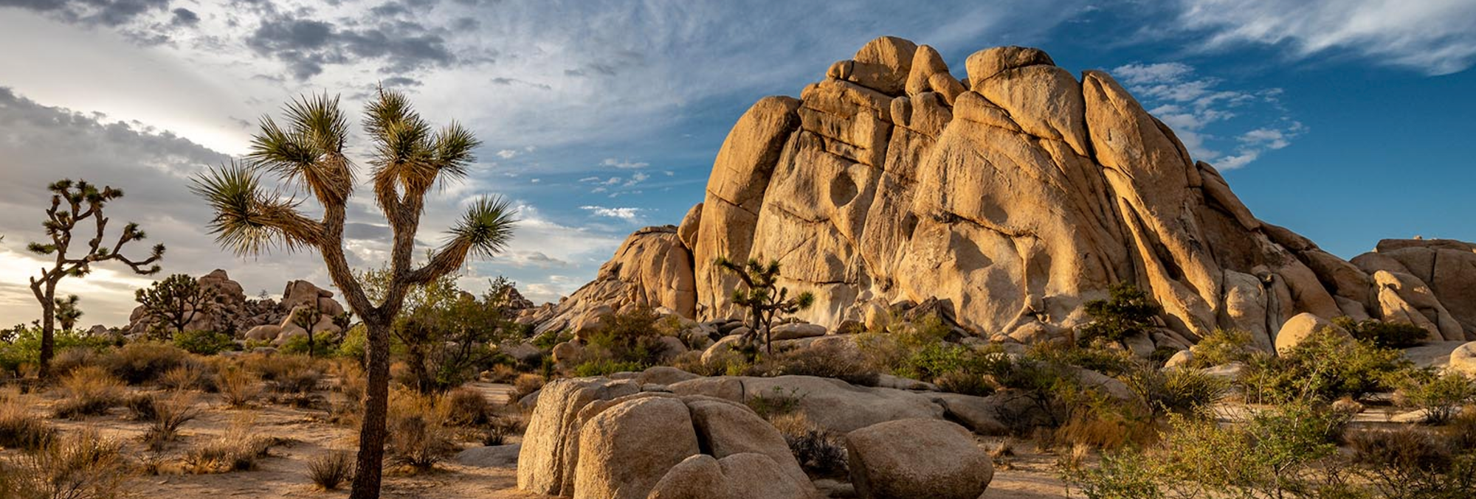


2025 Urban Water Management Plan
Presentation to the Joshua Basin Water District Board
Wednesday May 20, 2026

Slide 2


Overview/Topics
General Requirements
Urban Supplier Defined
Service Area Information
Supply Characterization
Projected Water Use
Water Service Reliability
Water Shortage Contingency Plan
Fundamental Findings

Slide 3
General UWMP Requirements
The Urban Water Management Planning Act requires:
UWMPs to be submitted to the State by July 1 every five years
Requirements can be addressed through the development and submittal of a Regional Urban Water Management Plan
25-Year Planning Document
Service Area Description
Supply Characterization
Population and Demand Projections
Demand Management
Reliability Assessment
Near-Term Drought Risk Assessment (DRA)
Long-Term Service Reliability
5 Consecutive Dry Year Reliability
Water Shortage Contingency Plan (WSCP)
Action Plan for responding to water supply shortage

Slide 4





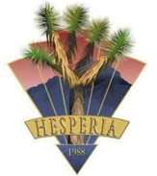


2025 Mojave Regional UWMP
10 Mojave area urban water retail suppliers and the Mojave Water Agency have prepared a Regional UWMP for the 2025 reporting cycle
The 2025 RUWMP Provides:
Coordinated efforts in planning for potential water shortages
Consistent characterization of regional supplies
Consistent messaging regarding reduced Delta Reliance
Coordinated outreach efforts

Slide 5
2025 Mojave Regional UWMP - Structure
Executive Summary | Overview of region, retailers, and summary of water supply reliability
Regional Chapter 1 | Introduction
Regional Chapter 2 | The Mojave Region (Regional Overview)
Regional Chapter 3 | Regional Water Supply Characterization
Regional Chapter 4 | Water Use Characterization
Regional Chapter 5 | Regional Water Service Reliability
Chapter 6 | Mojave Water Agency Wholesale Chapter
Chapters 7 - 16 | Retailer Water Supplier Chapters
Appendices | A1. Notices A2. Reduced Delta Reliance Supporting Information A3. MWA “Regional” DWR Checklist A4. MWA WSCP

Slide 6
Urban Water Supplier Defined
Per California Water Code (CWC):
Defined as “a supplier, either publicly or privately owned, providing water for municipal purposes either directly or indirectly to more than 3,000 customers or supplying more than 3,000 acre-feet of water annually.” [CWC §10617]
Public Water System Number | 2025 Connections | 2025 Volume Supplied (acre-feet)
CA3610025 | 5,574 | 1,292
Notes:
5,574 = Total Connections (Active + Inactive)
4,881 Active
693 Inactive

Slide 7
Service Area information
Current Population: An urban retail water supplier shall determine population using federal, state, and local population reports and projections [CWC §10608.20(f)]
Current Population and Future Projections derived using data from:
2020 Census
Southern California Association of Governments Forecasts
Population study by the Center for Economic Forecasting and Development at the University of California, Riverside (Commissioned by MWA)
 | 2025 | 2030 | 2035 | 2040 | 2045 | 2050 | 2055 | 2060
Joshua Basin Water District | 10,375 | 10,536 | 10,673 | 10,800 | 10,919 | 11,029 | 11,131 | 11,225

Slide 8
Supply Characterization
JBWD’s supplies are managed groundwater resources supported by local storage and imported water recharge
Total Copper Mountain Valley Groundwater Basin Storage
Total Joshua Tree Groundwater Basin Storage
Recharge
264,000 Acre-Feet
293,000 Acre-Feet
MWA SWP Imports

Slide 9
Supply Characterization – Continued
Because sufficient supplies are available, the District extracts the groundwater needed to meet customer demands
For reliability planning, projected supplies are set equal to projected demand
Year Type |  | Managed Groundwater Production (AF)
Normal |  | 1,290
Single Dry Year |  | 1,290
Multi-Year Drought | 2026 (1st Year) | 1,290
 | 2027 (2nd Year) | 1,290
 | 2028 (3rd Year) | 1,295
 | 2029 (4th Year) | 1,300
 | 2030 (5th Year) | 1,300

Slide 10
Supply Characterization – Continued
Managed Groundwater Production (AF) |  | 2030 | 2035 | 2040 | 2045 | 2050
Normal |  | 1,300 | 1,315 | 1,330 | 1,340 | 1,350
Single Dry Year |  | 1,300 | 1,315 | 1,330 | 1,340 | 1,350
Multi-Year Drought | Year 1 | 1,300 | 1,315 | 1,330 | 1,340 | 1,350
 | Year 2 | 1,305 | 1,315 | 1,330 | 1,340 | 1,350
 | Year 3 | 1,305 | 1,320 | 1,330 | 1,345 | 1,355
 | Year 4 | 1,310 | 1,325 | 1,335 | 1,345 | 1,355
 | Year 5 | 1,310 | 1,325 | 1,335 | 1,350 | 1,360

Slide 11
Current and Projected Water Use
CWC §10631(d) states, For an urban retail water supplier, quantify, to the extent records are available, … projected water use…identifying the uses among water use sectors…
Projections informed on historical and projected conditions
Current Customer Water Use
Regulatory Conditions
Land Use Projections
Population Growth

Slide 12
Water Service Reliability
Drought Risk Assessment (DRA)
Evaluates the District’s ability to meet projected water demands over a five-year planning horizon under a sequence of dry conditions
DRA | 2026 | 2027 | 2028 | 2029 | 2030
 | (acre-feet)
Supply | 1,290 | 1,290 | 1,295 | 1,300 | 1,300
Demand | 1,290 | 1,290 | 1,295 | 1,300 | 1,300
Surplus/(Deficit) | 0 | 0 | 0 | 0 | 0

Slide 13
Water Service Reliability – Continued
Long Term Reliability (Normal and Single Dry Year Scenarios)
Normal Year | 2030 | 2035 | 2040 | 2045 | 2050
 | (acre-feet)
Supply | 1,300 | 1,315 | 1,330 | 1,340 | 1,350
Demand | 1,300 | 1,315 | 1,330 | 1,340 | 1,350
Surplus/(Deficit) | 0 | 0 | 0 | 0 | 0
Single Dry Year | 2030 | 2035 | 2040 | 2045 | 2050
 | (acre-feet)
Supply | 1,300 | 1,315 | 1,330 | 1,340 | 1,350
Demand | 1,300 | 1,315 | 1,330 | 1,340 | 1,350
Surplus/(Deficit) | 0 | 0 | 0 | 0 | 0

Slide 14
Water Service Reliability – Continued
Long Term Reliability (Multi Dry Year Scenario)
 |  | 2030 | 2035 | 2040 | 2045 | 2050
 |  | (acre-feet)
Year 1 | Supply | 1,300 | 1,315 | 1,330 | 1,340 | 1,350
 | Demand | 1,300 | 1,315 | 1,330 | 1,340 | 1,350
 | Surplus/(Deficit) | 0 | 0 | 0 | 0 | 0
Year 2 | Supply | 1,305 | 1,315 | 1,330 | 1,340 | 1,350
 | Demand | 1,305 | 1,315 | 1,330 | 1,340 | 1,350
 | Surplus/(Deficit) | 0 | 0 | 0 | 0 | 0
Year 3 | Supply | 1,305 | 1,320 | 1,330 | 1,345 | 1,355
 | Demand | 1,305 | 1,320 | 1,330 | 1,345 | 1,355
 | Surplus/(Deficit) | 0 | 0 | 0 | 0 | 0
Year 4 | Supply | 1,310 | 1,325 | 1,335 | 1,345 | 1,355
 | Demand | 1,310 | 1,325 | 1,335 | 1,345 | 1,355
 | Surplus/(Deficit) | 0 | 0 | 0 | 0 | 0
Year 5 | Supply | 1,310 | 1,325 | 1,335 | 1,350 | 1,360
 | Demand | 1,310 | 1,325 | 1,335 | 1,350 | 1,360
 | Surplus/(Deficit) | 0 | 0 | 0 | 0 | 0

Slide 15
Water Shortage Contingency Plan (WSCP)
WSCP establishes the framework through which the District evaluates water supply conditions and implements staged response actions during periods of constrained supply
Evaluation occurs via the Annual Water Supply and Demand Assessment
Stages of Implementation
Response actions escalate based on shortage severity, ranging from voluntary conservation to mandatory prohibitions
Shortage response stages address supply reductions from 10% to >50%

Slide 16
Water Shortage Contingency Plan – Continued
Implementation Actions
Public outreach and conservation messaging
Restrictions on non-essential water use
Increased enforcement measures
Implementation of demand reduction measures

Slide 17
Fundamental Findings
Substantial supplies exist in Copper Mountain Valley and Joshua Tree Basins
MWA determined sufficient supplies for the Region
Projected demands will increase with added population
Annual Assessment provides an annual mechanism to verify projections
Reliable water supplies are available and require active management within each year and across multiple years
Water service reliability maintained through planning horizon

Slide 18

Questions?

