Slide 1
FY 2025/26 Preliminary Financial Results
Fiscal year ended June 30, 2026 • Board Meeting September 16, 2026 • Agenda Item 7D
YEAR-END
SNAPSHOT
TOTAL CASH
TOTAL REVENUES
$30.59M
$13.93M
Strong liquidity and favorable operating results, with capital spending below anticipated levels.
+$5.56M vs. 6/30/25
109% of revised budget
OPERATING EXPENSES
NET REVENUES
BEFORE CAPITAL
$7.60M
$6.33M
Key caution
82% of revised budget
Capital expenditures and reserve funding are reflected separately from the income statement.
FY 2026/27 anticipates significantly higher capital spending, so recent cash growth should not be assumed to continue at the same pace.
Joshua Basin Water District | Preliminary / Unaudited
1
Notes:
[Sources]
JBWD 09/16/26 Item 7D staff report and JBWD Financials at a Glance, quarter ending 06/30/26.

Slide 2
Cash & investments reached $30.59 million at 06/30/26
06/30/26 Quarter-end liquidity increased $1.73 million; rolling 12-month increase was $5.56 million.
UNRESTRICTED
LEGALLY RESTRICTED
BOARD DESIGNATED
$0.36M
$6.41M
$23.82M
+65.9% vs prior year
+10.2% vs prior year
+25.4% vs prior year
Cash balance trend
06/30/25
$25.0M
03/31/26
$28.9M
06/30/26
$30.6M
Capital spending remained below anticipated levels during FY 2025/26, contributing to the cash increase.
Chromium-6 reminder: estimated project costs are approximately $20–$60 million, so current cash growth should be viewed in the context of significant upcoming capital needs.
Joshua Basin Water District | Preliminary / Unaudited
2
Notes:
[Sources]
JBWD Financials at a Glance: cash balances as of 06/30/26; Item 7D staff report executive summary.

Slide 3
Fourth-quarter cash flow 6/30/26
Cash receipts exceeded cash uses by approximately $1.73 million.
MAJOR SOURCES
MAJOR USES
Water payments
$2.24M
O&M / payroll
$1.63M
Property tax & assessments
$0.68M
$0.15M
Capital / inventory
Investment & misc.
$0.27M
Development charges
$0.17M
NET QUARTERLY INCREASE
HDMC reimb. & O/H
$0.07M
+$1.73M
$3.51M sources less $1.78M uses
Water payments represented roughly 64% of major quarterly cash sources.
Joshua Basin Water District | Preliminary / Unaudited
3
Notes:
[Sources]
JBWD Financials at a Glance: cash flow, quarter ending 06/30/26.

Slide 4
Revenues finished above budget; expenses below budget
Year-to-date actuals compared with the revised FY 2025/26 operating budget.
TOTAL REVENUES
OPERATING REVENUES
NON-OPERATING REVENUES
$13.93M
$9.41M
$4.52M
109.4% of $12.74M budget
102.1% of $9.22M budget
128.6% of $3.51M budget
Operating expense performance
Revised budget
$9.31M
Actual YTD
$7.60M
Result: $6.33 million of revenues over operating expenses before depreciation, capital costs and reserve funding.
Joshua Basin Water District | Preliminary / Unaudited
4
Notes:
[Sources]
JBWD Financials at a Glance: Operating Budget vs. Actual Costs, 06/30/26.

Slide 5
Accounts receivable remains the primary financial concern
Total receivables increased year over year, with $723,937 in the 120+ day category.
TOTAL A/R
120+ DAYS
DAYS SALES OUTSTANDING
$1.63M
$723,937
52.81 days
vs. $1.44M at 6/30/25
44% of total receivables
Essentially stable
Post-SB 998 era: Longer residential shutoff timelines can contribute to higher A/R balances by allowing delinquent amounts to accumulate longer before service discontinuation.
A/R aging at 6/30/26
Current
$604k
30–60 days
$275k
90 days
$26k
120+ days
$724k
Year-end bad debt: $53,968.56. Lien-related balances: $150,928.25; Prior bad debt totals: $298,760.52.
Average collection time remained relatively stable (collection velocity) despite higher billing volume.
Joshua Basin Water District | Preliminary / Unaudited
5
Notes:
[Sources]
JBWD Financials at a Glance: Accounts Receivable aging as of 06/30/26 and Item 7D staff report.

Slide 6
Investment earnings remained a meaningful revenue source
Quarterly investment earnings totaled $285,416; fiscal-year earnings were approximately $1.11 million.
QUARTER EARNINGS
LAIF
CAMP
$285,416
$232,176
$53,240
LAIF + CAMP
Quarter earnings • 3.92%
Quarter earnings • 3.78%
Investment balances at quarter end
LAIF
$24.54M
CAMP
$5.69M
Combined investment balance: $30.23 million.
Joshua Basin Water District | Preliminary / Unaudited
6
Notes:
[Sources]
JBWD Financials at a Glance: Investments, quarter ending 06/30/26; Item 7D staff report.

Slide 7
Water Consumption was essentially flat year over year at 06/30/26
Rolling 12-month consumption declined 0.23%, while development-related activity contributed additional revenue.
FY 2025/26 CONSUMPTION
TWO-YEAR CHANGE
NEW CONNECTIONS
504,996 units
+9.38%
18 YTD
-0.23% vs. prior year
vs. FY 2023/24
$421,297 accrual-basis total
Rolling 12-month consumption
FY 2023/24
462k units
FY 2024/25
506k units
FY 2025/26
505k units
Quarter development charges totaled $173,236 on a cash basis; six total new connections were recorded as of 6/30/26 preliminary.
Joshua Basin Water District | Preliminary / Unaudited
7
Notes:
[Sources]
JBWD Financials at a Glance: Consumption and Development Charges, quarter ending 06/30/26.

Slide 8
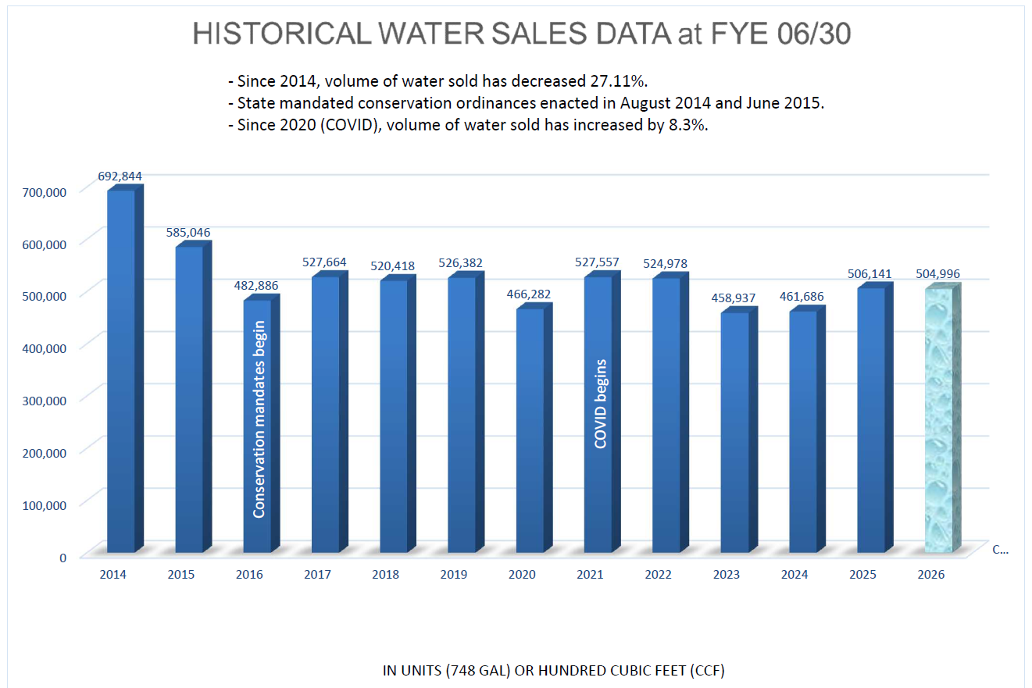
Joshua Basin Water District | Preliminary / Unaudited
Historical water sales data at FYE 06/30
Conservation
mandates begin
9

Slide 9
Recent cash accumulation and future capital needs
Recent favorable results have increased financial capacity while significant capital needs remain ahead.
Recent financial results
Over the past several years, the District has accumulated more cash than anticipated. A significant part of that result has come from spending below budget, including capital projects and other expenditures delayed by operational constraints.
What favorable variances represent
Those favorable variances should not be interpreted as evidence that the underlying needs went away. In many cases, the spending has simply moved into future years.
Preparing for the capital cycle ahead
The timing has nevertheless put the District in a stronger position as it approaches a major capital cycle. Accumulated cash can help fund upcoming projects, reduce borrowing, support debt-service requirements, and lessen future pressure on rates.
Future rate considerations
Future rate decisions should be evaluated through an updated multi-year financial forecast that considers operating needs, capital requirements, reserves, and financing — rather than the cash balance alone.
Key message: Cash accumulated earlier than expected; significant capital spending remains ahead.

Slide 10
Board takeaways
Preliminary / unaudited year-end results support a strong financial position while highlighting areas to watch.
1
Liquidity is strong
$30.59M cash and investments; +$5.56M year over year.
2
Operating results were favorable
Revenues above revised budget and expenses below budget.
3
Capital timing matters
Lower FY 2025/26 capital spending boosted cash; FY 2026/27 anticipates higher capital activity. Major Chromium 6 costs are forthcoming.
4
Receivables require continued attention
$1.63M total A/R, including $724k aged 120+ days. Post-SB 998 shutoff timelines contribute to longer collection cycles.
Audited Financial Statements should be coming to the Board in November.
Recommended action: Review and approve the preliminary / unaudited financial report.
Joshua Basin Water District | Preliminary / Unaudited
8
Notes:
[Sources]
JBWD 09/16/26 Item 7D staff report and Financials at a Glance, 06/30/26.

