Slide 1

25/26 REVISED BUDGET 26/27 PROPOSED BUDGET
Presented 05/11/26
By Director of Finance Roman

Slide 2
INTRODUCTION / OVERVIEW

Slide 3
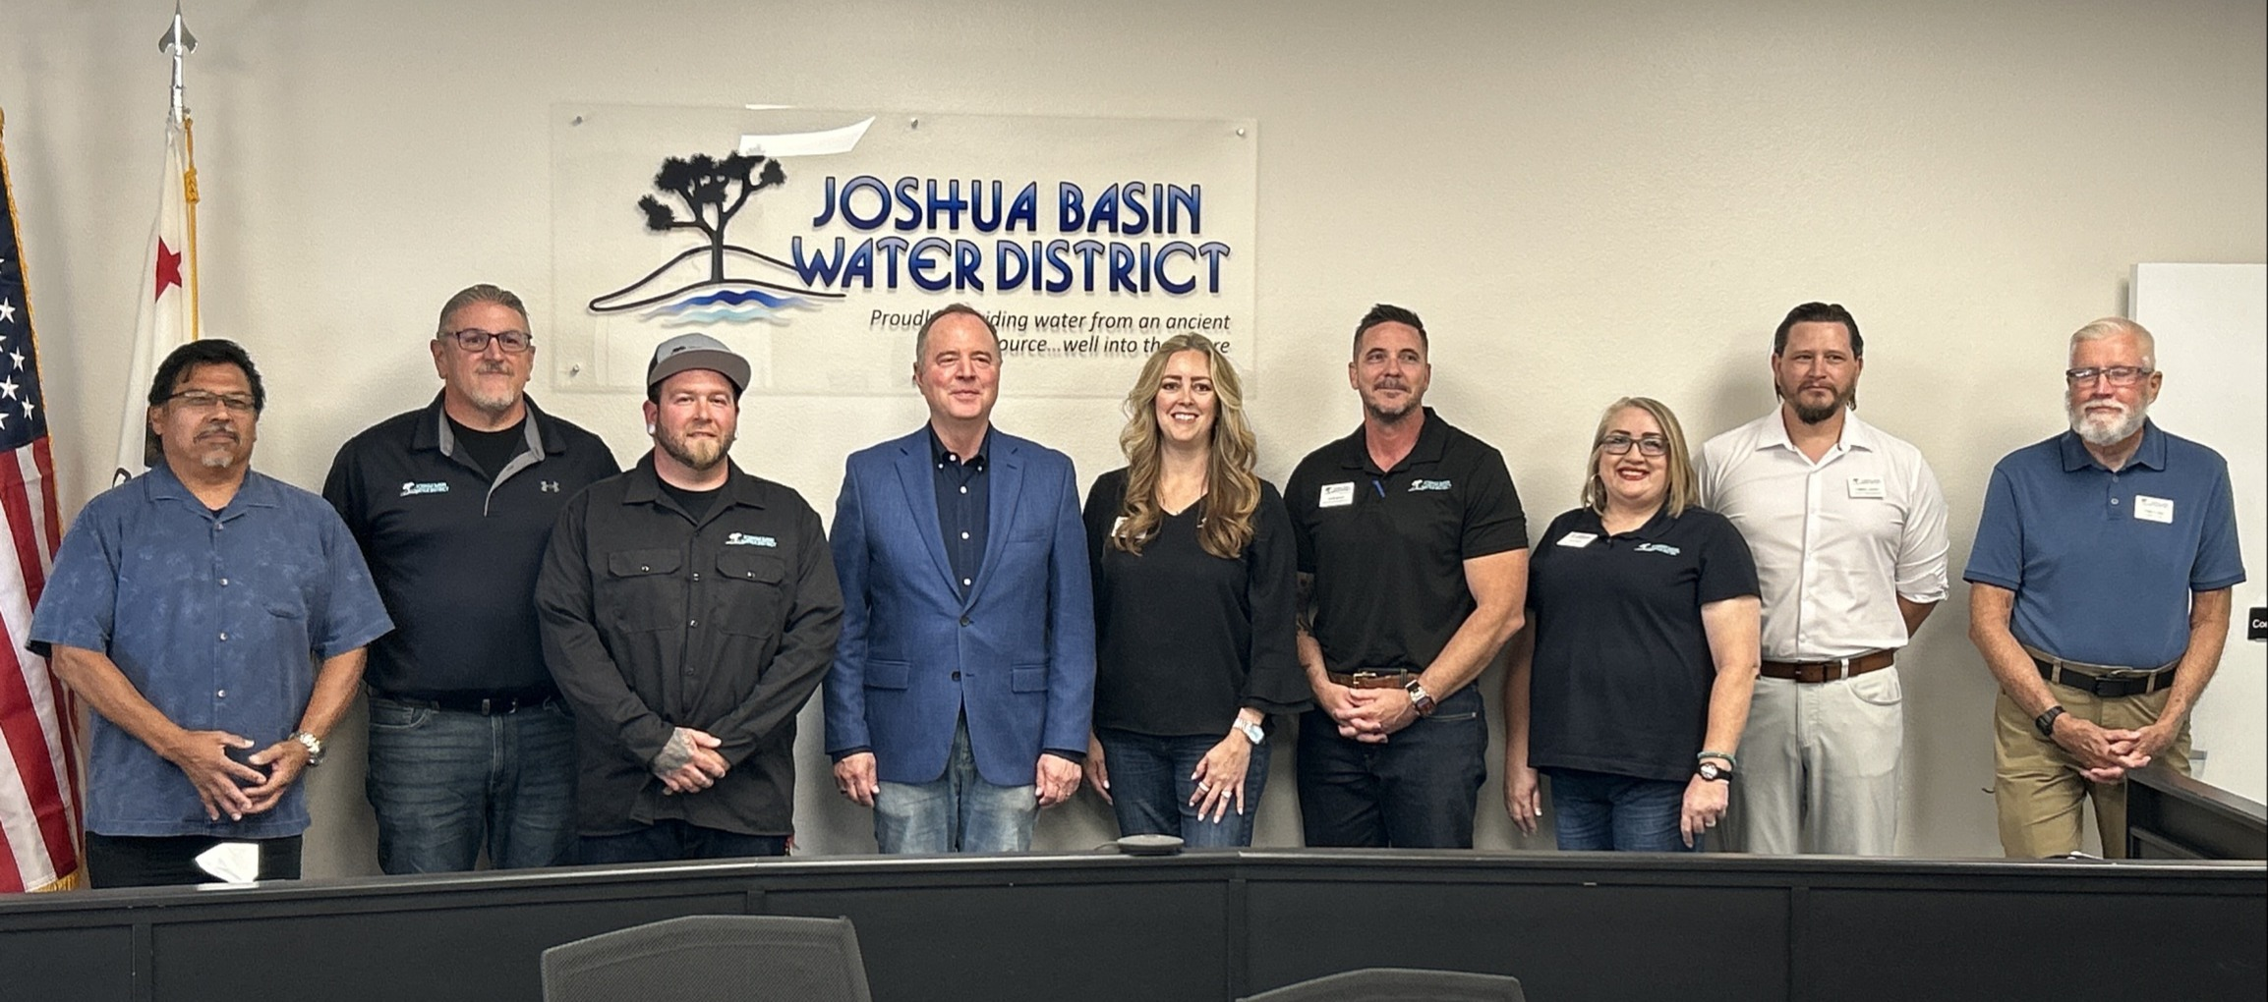
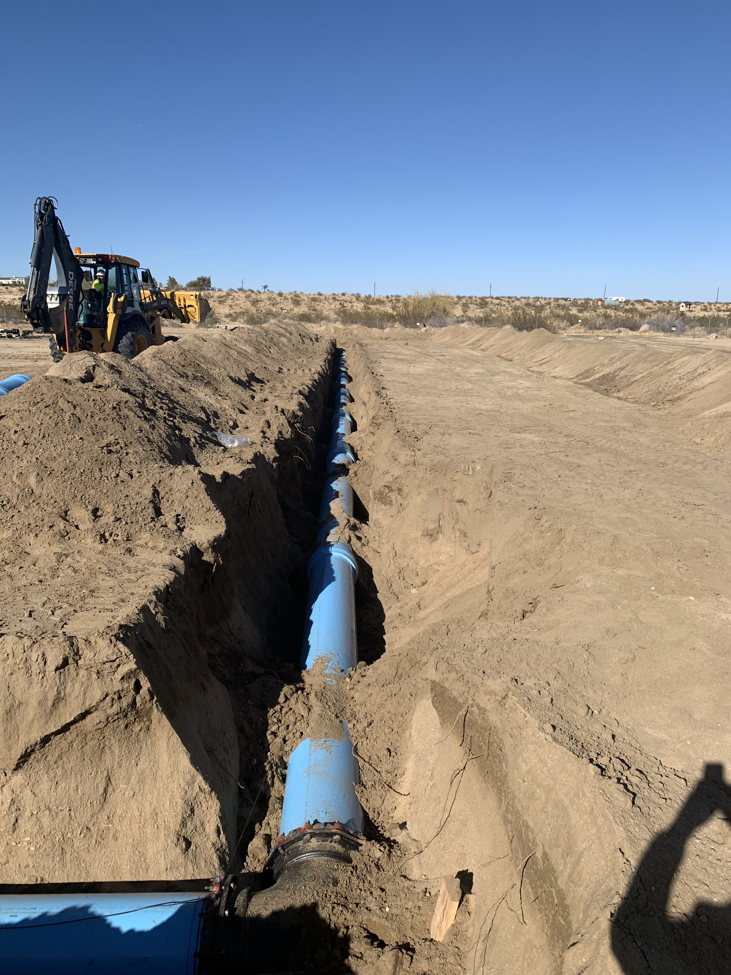
ABOUT THE DISTRICT
Joshua Basin Water District was formed as a public agency in 1963 after combining several smaller systems. Today, the District serves more than 5,600 active and inactive connections in a 96-square-mile service area. Since our formation, we have remained dedicated to providing our customers with the highest quality drinking water. To safely deliver nearly 600 million gallons of high-quality water to customers each year from the groundwater basins, the district maintains an extensive system consisting of:
Office & Shop Facilities
Fleet Vehicles & Heavy Equipment
Approximately 300 miles of pipeline
5 Groundwater wells
17 Reservoir tanks (capacity of 12,330,000 gallons)
12 Booster pump stations
12 Pressure-reducing stations
1,426 Fire hydrants
Recharge ponds
Maintenance of Hi-Desert Medical Center's Wastewater Treatment Facility
A Water conservation Demonstration garden
The District is regulated by strict compliance standards set by federal, state, and other regulators and governed by a publicly elected five-member Board of Directors. The District is divided into Operations, Finance, and Administration and is managed by a General Manager who is appointed by the Board of Directors.
The Fiscal Year 2026/27 proposed budget entails:
Operational (non-Capital) cost of $10,262,559 million, including 5 reports & studies.
Capital cost of $6.08 million, including 24 projects.
The District employs approximately 25 Operations and Administrative staff.
The District maintains a general fund and 16 reserve funds for designated purposes.

Slide 4
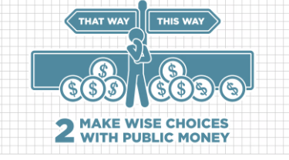

Local governments are meant to be enduring institutions. They have a responsibility to chart a sustainable financial trajectory and build resiliency or the capacity to bounce back from setbacks. The budget process should ensure that today’s choices do not compromise the ability of future generations to provide good public services to the community.
WHY WE BUDGET
Excerpt from Government Finance Officers Association (GFOA) article Rethinking Budgeting Core Principles > Why We Budget
https://www.gfoa.org/long-form/why-we-budget?_zs=D7SOj1&_zl=T0t9A

Slide 5
Operating vs. Non-Operating Revenues & Expenses FUNDING THE CORE MISSION: WATER
Excerpt from JBWD’s Budget Policy:
Best Practice:
Operating revenues and expenses relate to daily water service delivery, the core mission, while non-operating items involve external funding sources and costs not tied to regular operations.
It is critical that operating revenues cover operating expenses to ensure the District remains financially self-sufficient in its core mission of delivering water service. Relying on non-operating revenues, such as taxes or grants, to fund basic operations can expose the District to financial instability if those external sources fluctuate or are reduced.
Maintaining a balance where water service charges fully support operational costs promotes fiscal responsibility, protects long-term sustainability, and ensures ratepayer equity.
Operating Revenues…must fully cover Operating Expenses, including debt service. Operating Expenses for the purposes of balancing the annual budget shall include that year’s contribution to the various Reserve and Replacement Reserve Funds as determined in the Reserve Policy and as funded by the effective Rate Study.
The balancing of Operating Revenues with Operating Expenses (as defined above) is a goal that should be applied over a period of time which extends beyond the current budget. Temporary shortages or operating deficits can and do occur, but they will not be permitted as extended trends.
The District strives to fund its basic operations through operating revenues, reserving non-operating revenues for capital projects or other non-routine purposes.
Both presented budgets meet this goal.

Slide 6
COMBINED BUDGET

Slide 7

OVERVIEW
This budget contains staff’s best projection of costs.
The 2023 rate study assumes a 4% Operating expense increase per year; The 26/27 increase is 6% over the original 25/26 budget.
Total Operational (non-Capital) expenses are at $10,262,559.
The Capital budget of $6.08 million brings the drawdown for 26/27 to $3.178 million.
Reserves at 6/30/27 are projected to cover six months of Operating expenses, as required by Reserve Policy.
Operating revenues, which should meet or exceed Operating expenses, will cover Operating expenses.

Slide 8
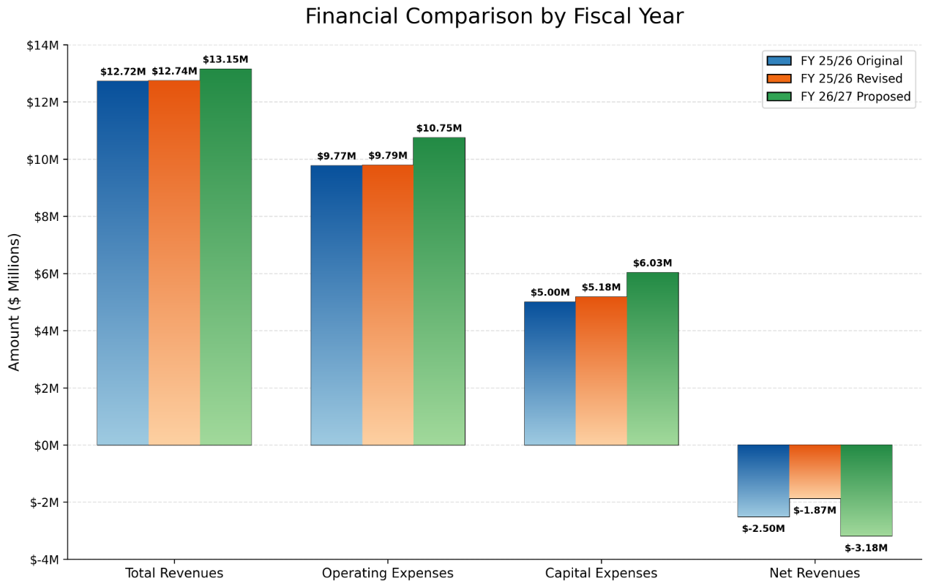

Slide 9
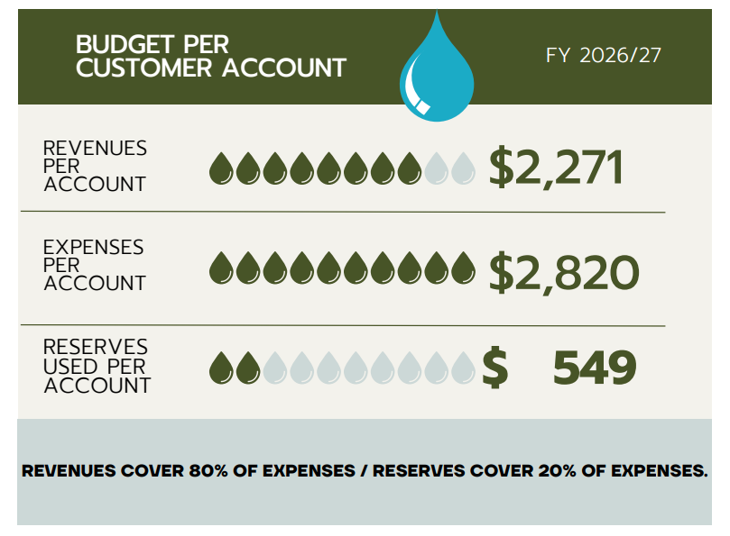
PER CUSTOMER REVENUE / RESERVE COVERAGE

Slide 10
OPERATING BUDGET

Slide 11
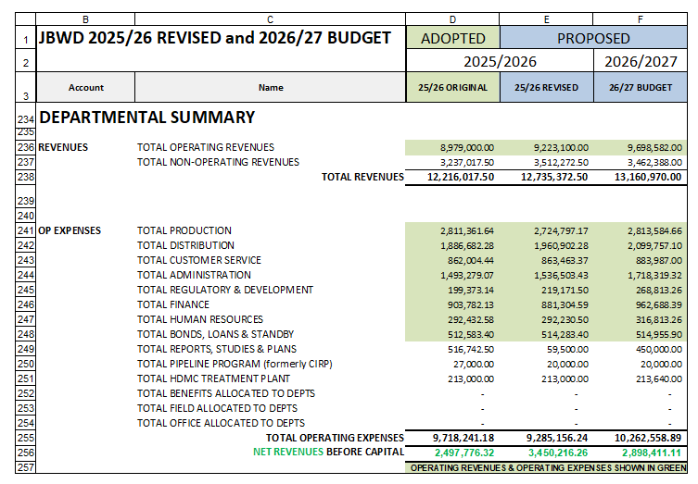
OPERATING: DEPARTMENTAL SUMMARY DRAWDOWN OF RESERVES / NET REVENUES BEFORE CAPITAL
Op revenue
$9,578,919 Op expenses (excludes non-operating expenses)
Refer to Page 16 of the Agenda packet.

Slide 12
OPERATING EXPENSE HIGHLIGHTS PRODUCTION & DISTRIBUTION DEPARTMENTS
2026/27:
Continued purchase of recharge water: 1,324 acre feet (AF) @ $639/AF is budgeted for a total of $846,036.
As we reach a point of being more staffed in Operations, accounts such as “Mainline and Leak Repair” are bolstered to accommodate additional maintenance work, such as the valve program. Budget is almost doubled from $80k in 25/26 to $150k in 26/27.

Slide 13
OPERATING EXPENSE HIGHLIGHTS ADMINISTRATION & FINANCE DEPARTMENTS
2026/27:
Costs related to Chromium 6, such as Grant Writing, Temporary Labor, and Accounting/Audit Services are increased.
Emergency Preparedness budget is increased to reflect an $8k grant-funded storage container purchase.
Prepayment of CalPERS Unfunded Accrued Liability (UAL) for 6th year in the amount of $54,601 to save about $150k -$180k in interest over 10 years; Included in GL account: RETIREMENT: PERS CLASSIC
This helps manage our Unfunded Accrued Liability (UAL) and protects our investment in Staff benefits, an important recruiting tool.
The consolidation of the Classic and PEPRA plans in the actuarial valuations reduced the Additional Discretionary Payment (ADP) under the 15-year schedule by spreading the unfunded liability over a longer, restructured period. To maintain an ADP contribution level closer to what we have historically paid and to achieve additional interest savings, we propose following the shorter 10-year amortization schedule beginning in FY 2026/27.
Having already made five years of elevated ADP payments under the 15-year schedule, transitioning to the lower-interest 10-year schedule is estimated to produce total interest savings of approximately $150,000 to $180,000, assuming we maintain that schedule over the next five years.

Slide 14
OPERATING EXPENSE REPORTS & STUDIES
****************Mandated in green**************
Water Master Plan including Capital Improvement Plan
$250k in 26/27
26/27 Water Rate Study $70k
Budget split $30k in 26/27;
$40k planned for 27/28
Emergency Response Plan & AWIA Risk & Resilience Plan
$65k total
Budget split $25k in 25/26;
$40k in 26/27
26/27 Wastewater Package Treatment Rate Study
(for billing of tract development wastewater package services)
$30k in 26/27
HDMC Wastewater Treatment Plant (WWTP) Monitoring Well Study in 26/27
$100k
Refer to Page 21 of the Agenda packet.

Slide 15
SALARIES

Slide 16
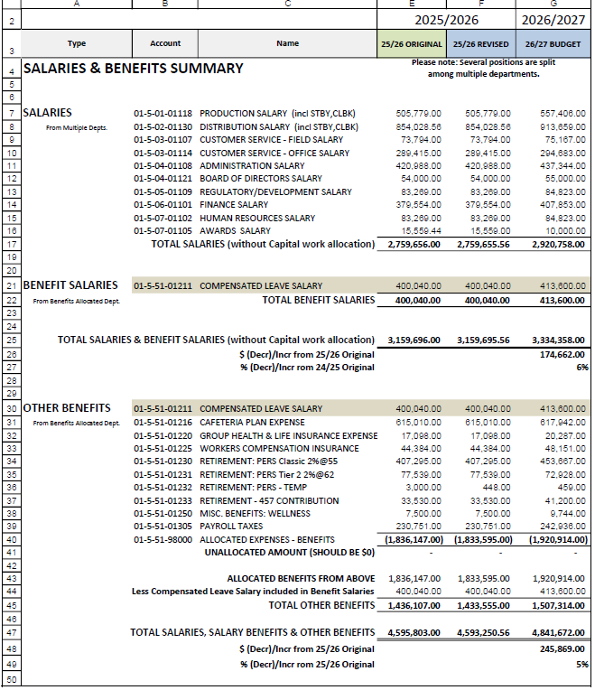
SALARY SUMMARY
The full Employee Compensation package will come to the Board in June.
Refer to Page 23 of the Agenda packet.

Slide 17
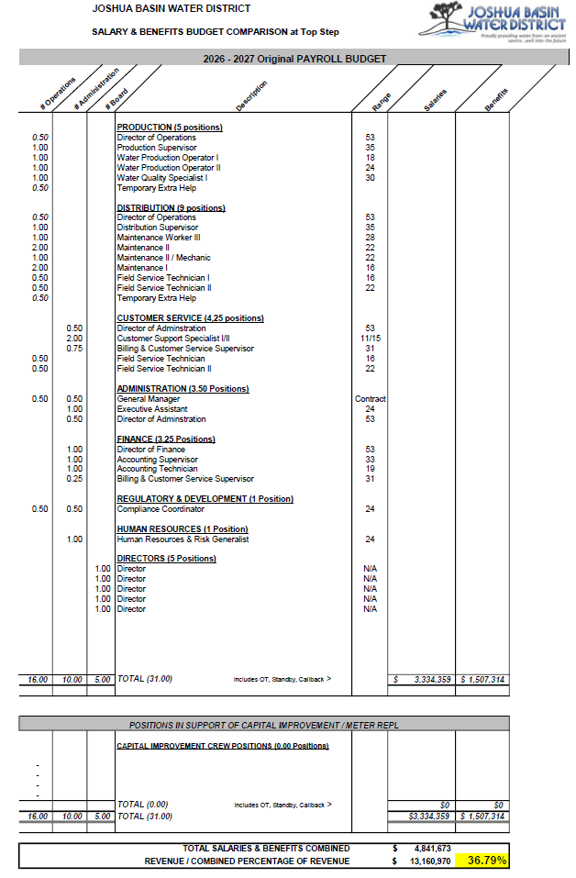
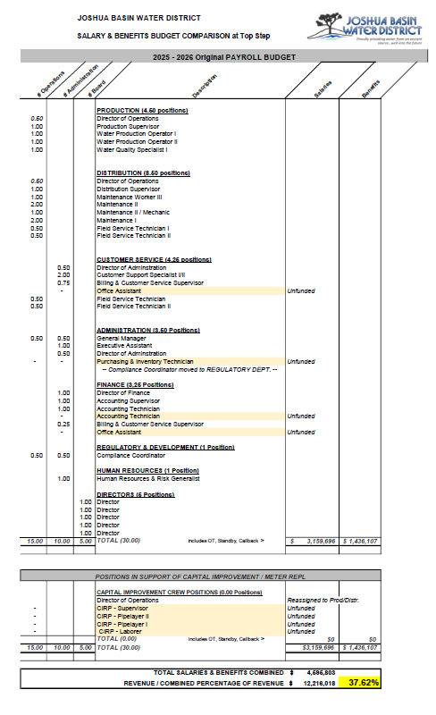
SALARY COMPARISON
Temporary Extra Help added for project support (24 projects + 5 Reports & Studies!)
Salaries & Benefits,
as a Percentage of Revenue, drop from 37.62% to 36.79%!
Refer to Page 24 - 25 of the Agenda packet.

Slide 18
BOTTOM LINE

Slide 19

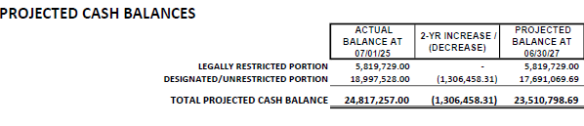
CASH RESERVE BALANCE PROJECTIONS
Refer to Page 17 of the Agenda packet.

Slide 20
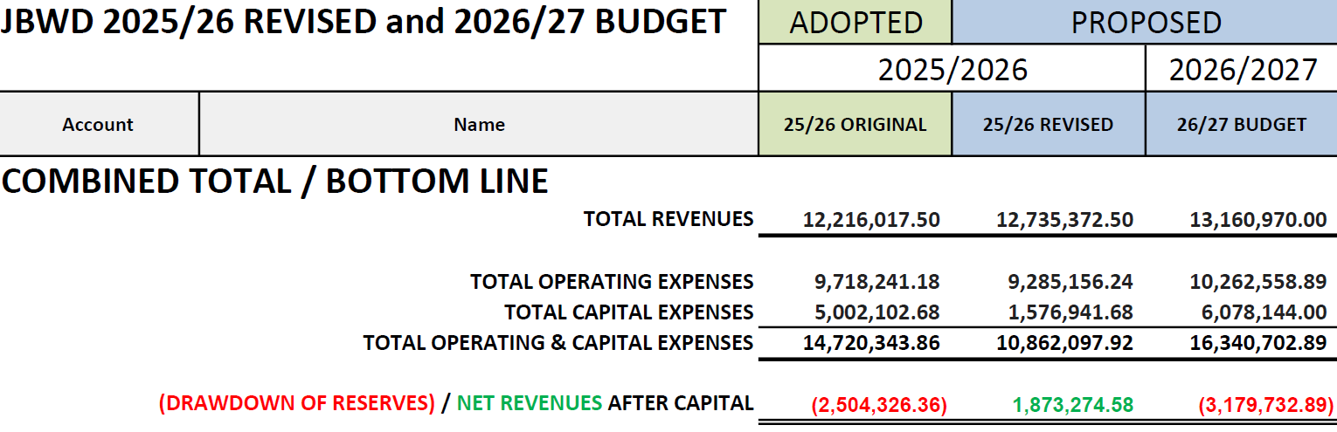
COMBINED TOTAL
Operating and Cash Flow reserves are projected to cover six months of Operating expenses, as required by the Reserve Policy.
Refer to Page 17 of the Agenda packet.

Slide 21
BOTTOM LINE & KEY TAKE-AWAYS
25/26 REVISED
26/27 PROPOSED
Net revenues of $1,873,275
Drawdown of $3,179,733
TWO YEAR RESERVE IMPACT PROJECTION:
Cash reserves decrease by $1,306,458 to $23,510,799 ($17,691,070 unrestricted) by 06/30/27
KEY TAKE-AWAYS ABOUT COMBINED BUDGET
Increased reserve reliance to fund capital initiatives
Total expenditure growth outpaces operating revenue growth
Long-term funding strategies for major capital obligations will include rate adjustments and seeking earmarks, grants, and loans.
Refer to Page 15 of the Agenda packet.

Slide 22
FORTHCOMING CHANGES TO FINAL BUDGET (not included in today’s figures)
25/26 Revised
GENERAL ENGINEERING
26/27
GENERAL ENGINEERING or Add’l REPORT & STUDY
Add $25k for General support services.
Add $150k for structuring the Development Process, Updating Specifications & Standards, and incorporating those changes into the Rules & Regulations. This will likely be treated as a “Report & Study.”

Slide 23

Staff will recommend adopting the 2025/26 Revised Budget and 2026/27 Proposed Budget at the June 3rd meeting.
STAFF RECOMMENDATION

Slide 24


QUESTIONS

