Slide 1

25/26 REVISED BUDGET
26/27 PROPOSED BUDGET
Presented 06/03/26
By Director of Finance Roman

Slide 2
INTRODUCTION / OVERVIEW

Slide 3
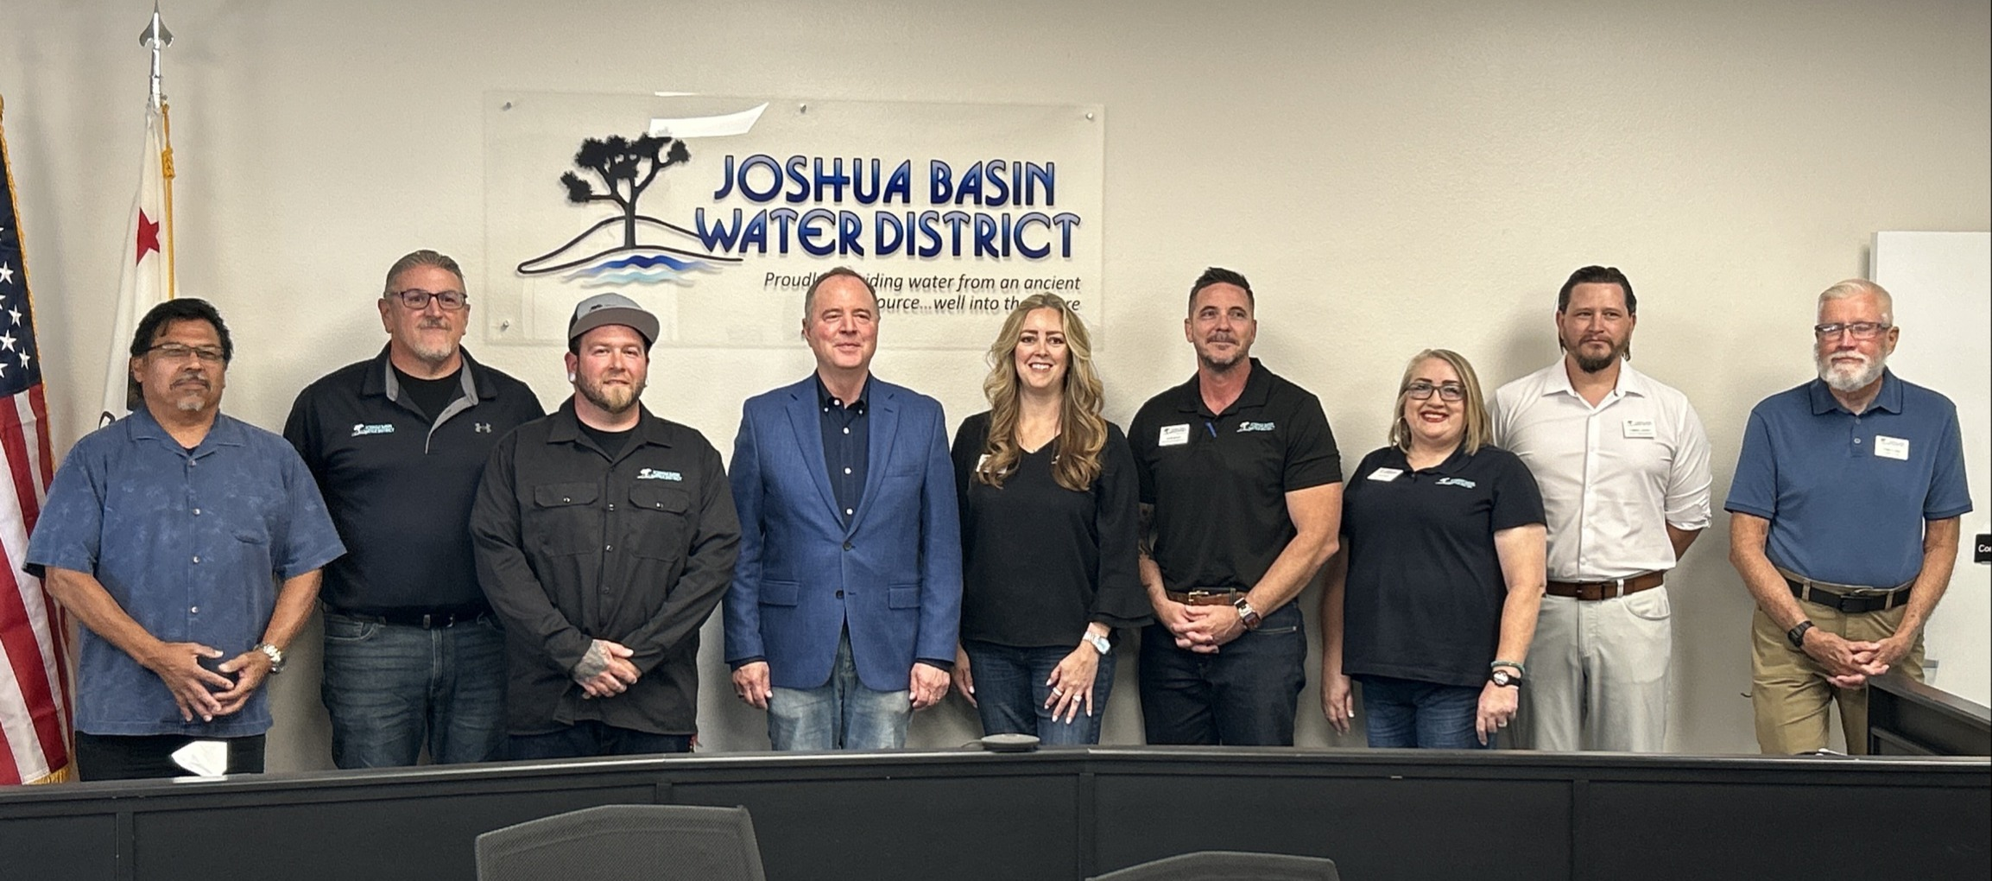
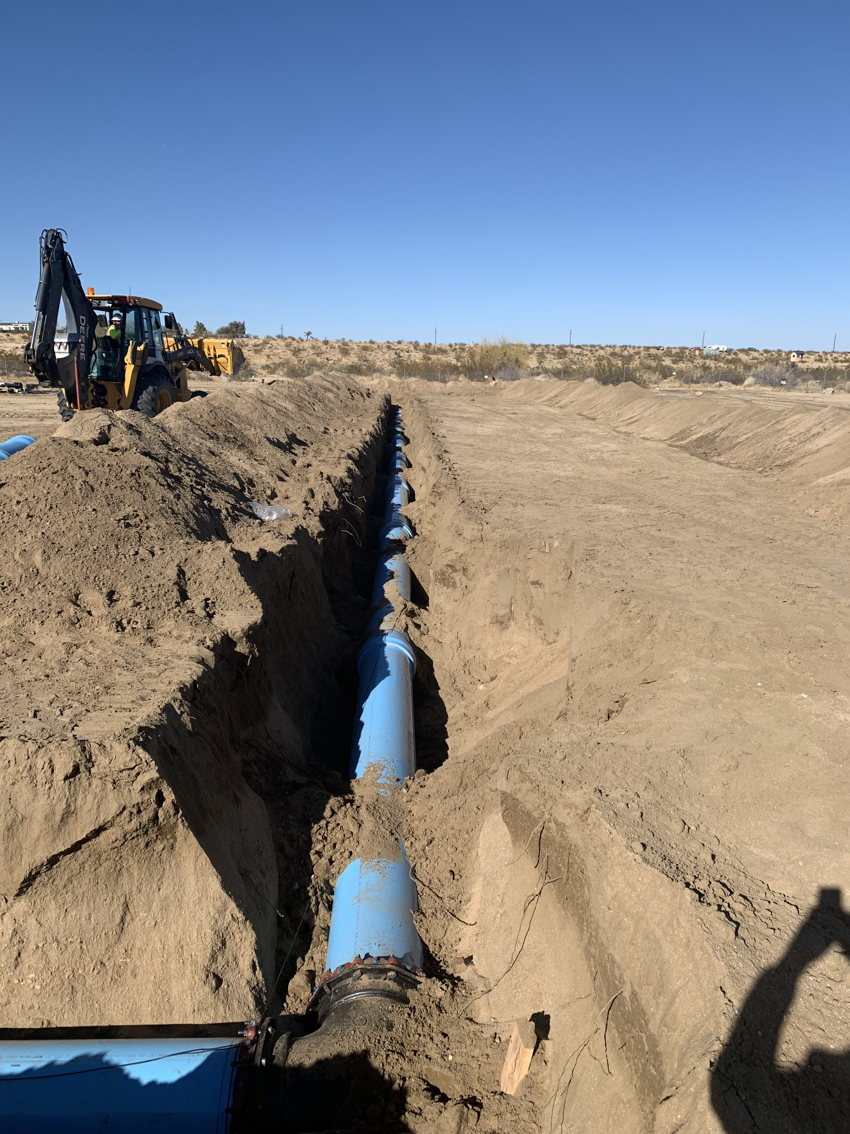
ABOUT THE DISTRICT
Joshua Basin Water District was formed as a public agency in 1963 after combining several smaller systems. Today, the District serves more than 5,600 active and inactive connections in a 96-square-mile service area. Since our formation, we have remained dedicated to providing our customers with the highest quality drinking water. To safely deliver nearly 600 million gallons of high-quality water to customers each year from the groundwater basins, the district maintains an extensive system consisting of:
Office & Shop Facilities
Fleet Vehicles & Heavy Equipment
Approximately 300 miles of pipeline
5 Groundwater wells
17 Reservoir tanks (capacity of 12,330,000 gallons)
12 Booster pump stations
12 Pressure-reducing stations
1,426 Fire hydrants
Recharge ponds
Maintenance of Hi-Desert Medical Center's Wastewater Treatment Facility
A Water conservation Demonstration garden
The District is regulated by strict compliance standards set by federal, state, and other regulators and governed by a publicly elected five-member Board of Directors. The District is divided into Operations, Finance, and Administration and is managed by a General Manager who is appointed by the Board of Directors.
The Fiscal Year 2026/27 proposed budget entails:
  Operational (non-Capital) cost of $10.8 million, including 6 reports & studies.
  Capital cost of $6.178 million, including 24 projects.
  The District employs approximately 25 Operations and Administrative staff.
  The District maintains a general fund and 16 reserve funds for designated purposes.

Slide 4

OVERVIEW
This budget contains staff’s best projection of costs.
The 2023 rate study assumes a 4% Operating expense increase per year; The 26/27 increase is 11% over the original 25/26 budget with new staffing and consultant options to better support the Strategic Plan and Chromium 6 goals.
Total Operational (non-Capital) expenses are at $10.8 million.
Total Capital budget of $6.178 million.
Drawdown for 26/27 of $3.818 million.
Reserves at 6/30/27 are projected to cover six months of Operating expenses, as required by Reserve Policy.
Operating revenues, which should meet or exceed Operating expenses, do NOT cover Operating expenses. The District’s Budget Policy permits this temporarily but not long term.

Slide 5
CHANGES SINCE
05/18/26 MEETING

Slide 6
CHANGES SINCE 05/18/26
STAFFING & CONSULTING:
Engineering Contract Services (consulting Engineer)
  Increase from $100k to $150k
Grant Writing & Management (consulting Grant Writer and Manager)
  Increase from $100k to $150k
Temporary Labor – Office (in-house regular or temp employees)
  Increase from $30k to $200k for TBD new positon(s)
  To cover salaries and benefits, depending upon timing of hire.
Engineering Tech:
  Was already included but originally budgeted as unfilled Production Operator I
Extra Help
  Was already included in Salaries (split between Production & Distribution)
Total increase to Operating Costs: $289K
Increase to Capital costs: $100K
TOTAL COST INCREASES SINCE 5/18/26: $389K
OTHER CHANGES:
AMI: increase from $100k to $200k
457 Employer contribution increased by $19k (inadvertently left out of Staff report).
Refer to Page 335 of the Agenda packet.

Slide 7
COMBINED BUDGET

Slide 8
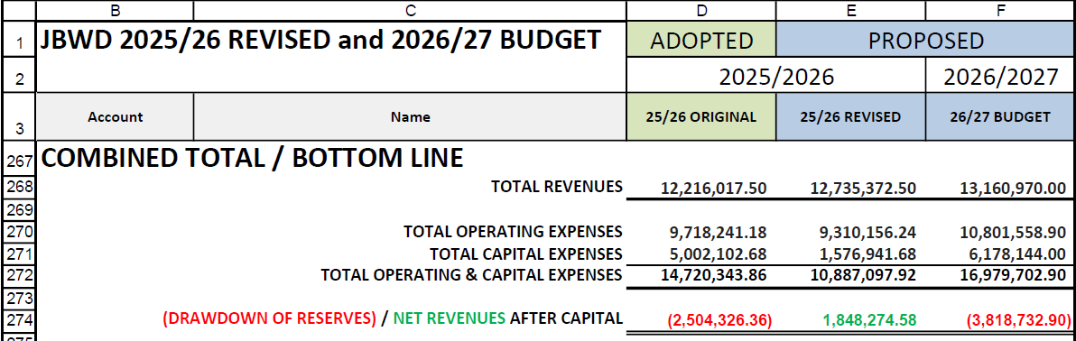
COMBINED TOTAL
Operating and Cash Flow reserves are projected to cover six months of Operating expenses, as required by the Reserve Policy.
Refer to Page 340 of the Agenda packet.

Slide 9
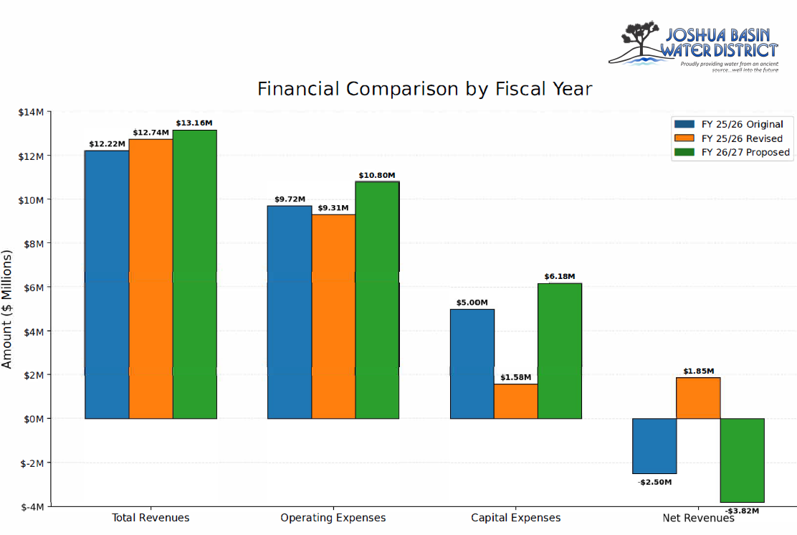
Refer to Page 341 of the Agenda packet.

Slide 10
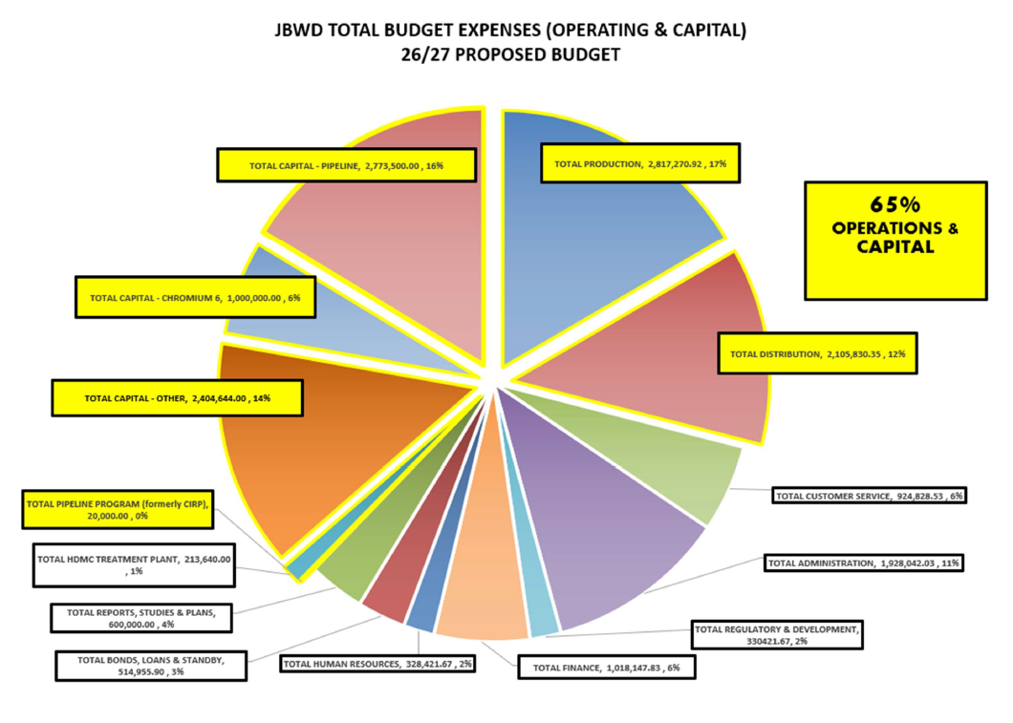
Refer to Page 342 of the Agenda packet.

Slide 11
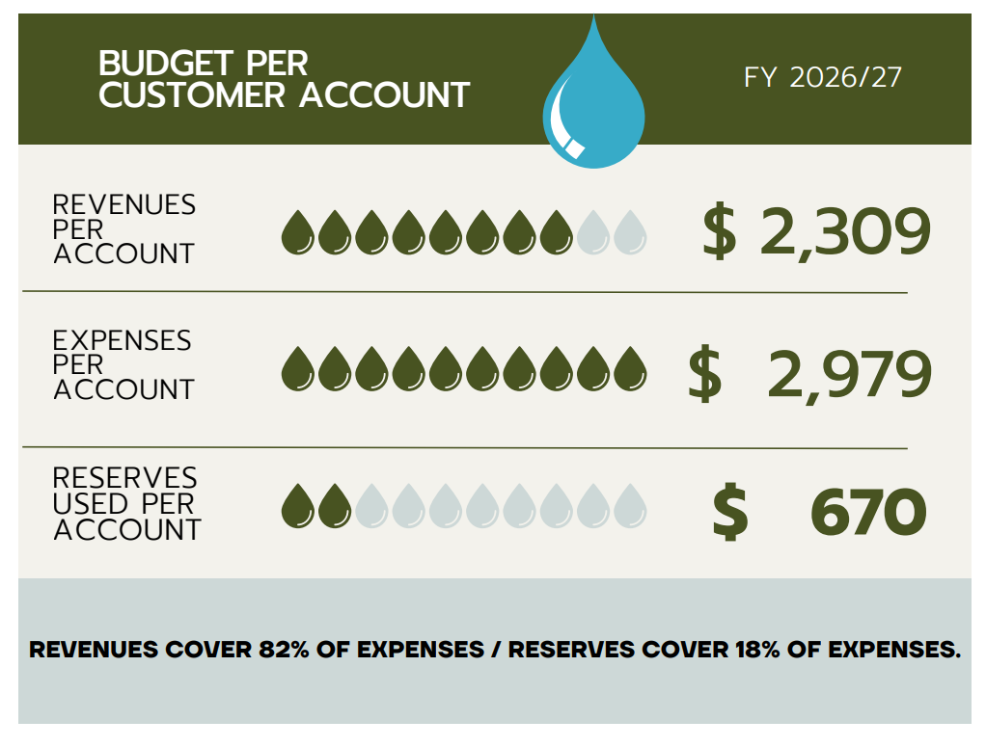
PER CUSTOMER REVENUE / RESERVE COVERAGE

Slide 12
OPERATING BUDGET SUMMARY

Slide 13
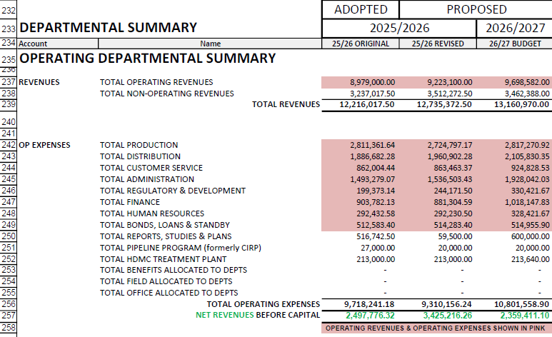
OPERATING BUDGET DEPARTMENTAL SUMMARY
Operating revenues =
$9,698,582
Operating expense =
$9,967,919
Operating deficit =
$269,337
With recent changes made to better support the District’s Strategic Plan, the FY 2026/27 Proposed Budget reflects an operating deficit, with operating revenues falling approximately $269,337 short of operating expenses. This signifies that ongoing operating costs are beginning to outpace recurring, rate revenues, increasing reliance on reserves and future rate adjustments to maintain long-term financial stability.
Refer to Page 339 of the Agenda packet.

Slide 14
OPERATING REVENUES VS. OPERATING EXPENSES
Operating revenues = $9,698,582
(revenues from water rates)
Operating expense = $9,967,919
(expenses related to providing water service)
Operating deficit = $269,337
With recent changes made to better support the District’s Strategic Plan, the FY 2026/27 Proposed Budget reflects an operating deficit, with operating revenues falling approximately $269,337 short of operating expenses. This signifies that ongoing operating costs are beginning to outpace recurring, rate revenues, increasing reliance on reserves and future rate adjustments to maintain long-term financial stability.
Excerpt from the Budget Policy:
The balancing of Operating Revenues with Operating Expenses…is a goal that should be applied over a period of time which extends beyond the current budget. Temporary shortages or operating deficits can and do occur, but they will not be permitted as extended trends.

Slide 15
SALARY SUMMARY

Slide 16
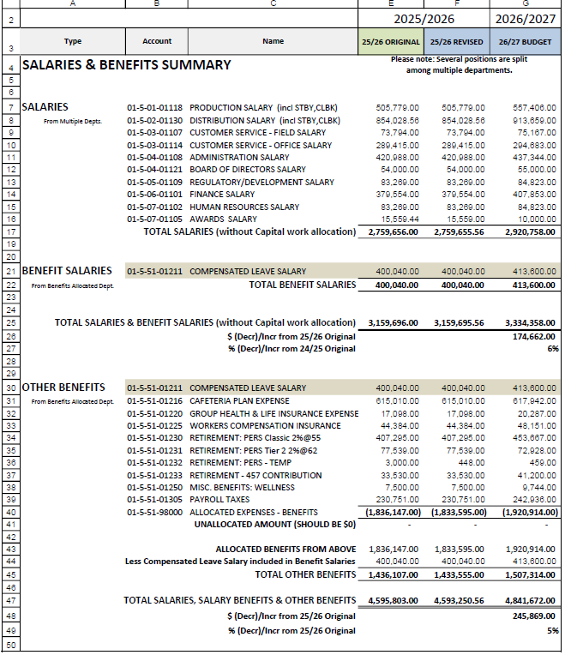
SALARY SUMMARY
The full Employee Compensation package will come to the Board in June.
Refer to Page 349 of the Agenda packet.

Slide 17
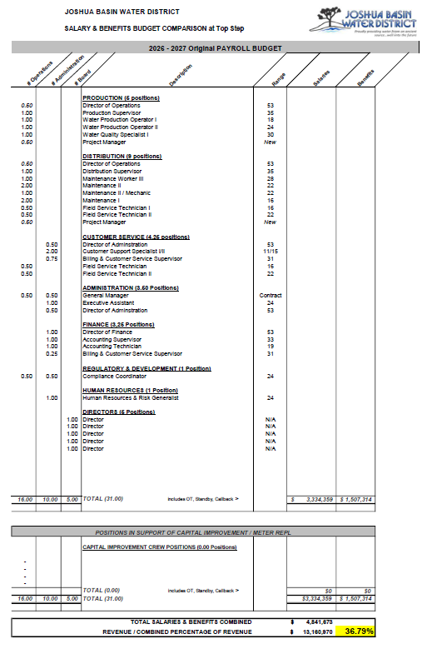
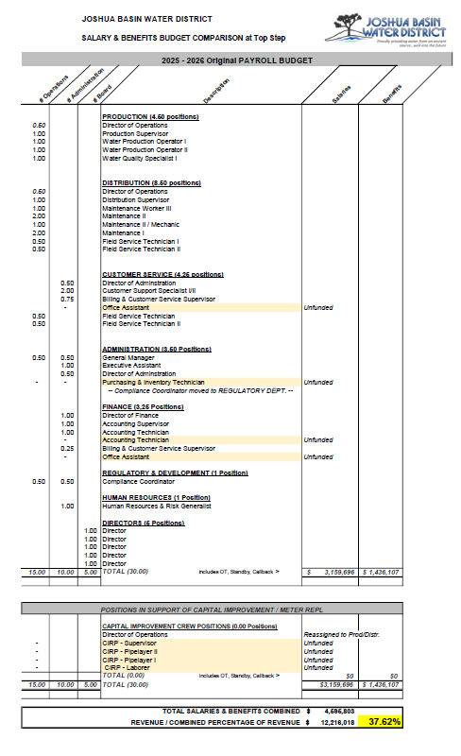
SALARY COMPARISON
One part-time Project Manager position added.
Salaries & Benefits,
as a Percentage of Revenue, drop from 37.62% to 36.79%!
Refer to Page 351-352 of the Agenda packet.

Slide 18
CAPITAL BUDGET SUMMARY &
RESERVE USE

Slide 19
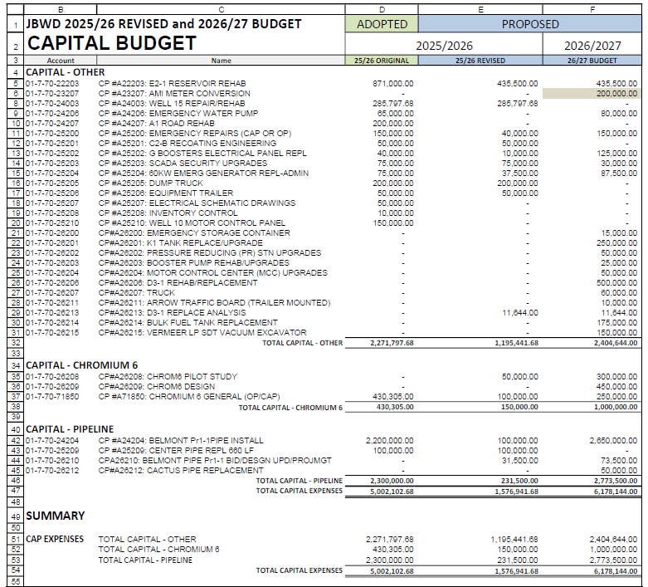
CAPITAL BUDGET
24 projects – an AMIBITIOUS list!
Refer to Page 353 of the Agenda packet.

Slide 20
EXCERPT FROM CAPITAL-OTHER BUDGET
INFRASTRUCTURE | 2025/26 REV | 2026/27 | 2-YEAR TOTAL
E2-1 Reservoir Upgrade | 435,500 | 435,500 | 871,000
K1 Tank Replacement/Upgrade | 0 | 250,000 | 250,000
D3-1 Rehab/Replacement | 0 | 500,0000 | 500,000
Well 15 Repair/Rehab | 285,798 | 0 | 285,798
AMI Meter Conversion | 0 | 200,000 | 200,000
Emergency Water Pump | 0 | 80,000 | 80,000
G Boosters Electrical | 10,000 | 125,000 | 135,000
60W Emergency Generator at Admin Bldg | 37,500 | 87,500 | 125,000
Emergency Storage Container | 0 | 15,000 (less possible $8k MWA grant) | 15,000 (less possible $8k MWA grant)
Emergency Water Pump | 0 | 80,000 | 80,000
Bulk Fuel Tank Replacement | 0 | 175,000 | 175,000
Truck | 0 | 60,000 | 60,000
Vermeer LP SDT Vacuum Excavator | 0 | 150,000 (less potential trade) | 150,000 (less potential trade)

Slide 21
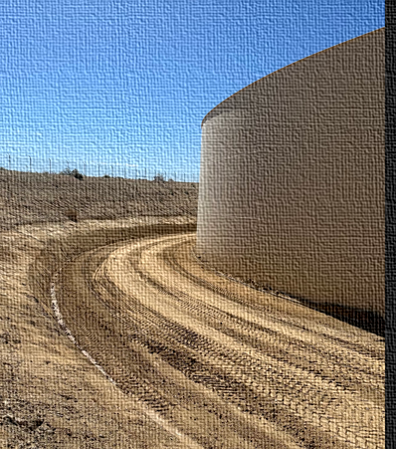
EXCERPT FROM CAPITAL-OTHER BUDGET, cont’d
Listed as Capital but may be moved to Operating
INFRASTRUCTURE | 2025/26 REV | 2026/27 | 2-YEAR TOTAL
Pressure Reducing Stations | 0 | 50,000 | 50,000
Booster Pump Rehabs | 0 | 25,000 | 25,000
Motor Control Centers | 0 | 50,000 | 50,000
Emergency Repairs (Cap or Op) $150k | 40,000 | 150,000 | 190,000
Other Projects Total:
  $1.2 million in 25/26 Revised
  $2.4 million in 26/27
Refer to Page 353 of the Agenda packet.

Slide 22
CAPITAL BUDGET (CHROMIUM-RELATED)
Chromium 6 Pilot Study,
  $50k in 25/26 Revised
  $300k in 26/27
  Phibro-Tech contract already Board approved)
Chrom 6 Design
  $450k in 26/27
Chrom 6 General (miscellaneous costs; may be OPERATING)
  $100k in 25/26 Revised
  $250k in 26/27
Total Chromium:
  $150,000 in 25/26 Revised
  $1 million in 26/27
Refer to Page 353 of the Agenda packet.

Slide 23
CAPITAL BUDGET (PIPELINE REPLACEMENT)
NEW PHASING – PRIORITY 1, PHASE 1
Belmont Pr1-1 Bid/Construction Support/Design update
  $31,500 in 25/26 Revised
  $73,500 in 26/27
  (WCC contract already Board-approved)
Belmont Pr1-1 Pipeline Installation 16,000 LF
  $100,000 in 25/26 Revised
  $2.65 million in 26/27
Center Pipe Replacement 660 LF, $100k, 25/26 Rev.
Total Pipeline:
  $231,500 in 25/26 Revised
  $2.77 million in 26/27
Refer to Page 353 of the Agenda packet.

Slide 24
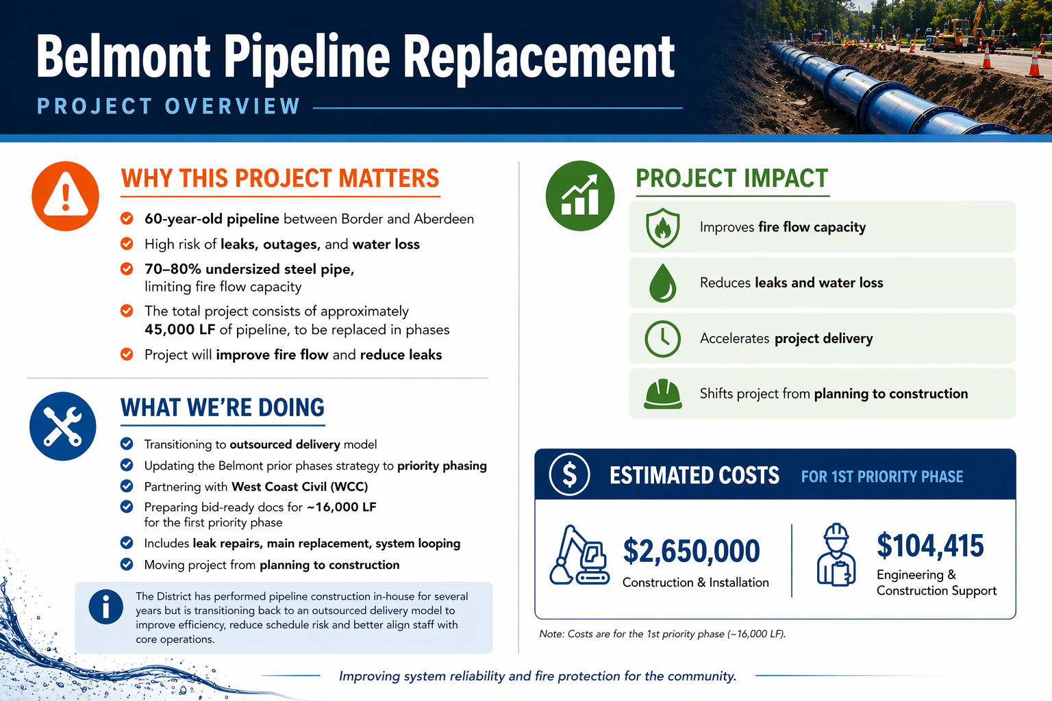

Slide 25
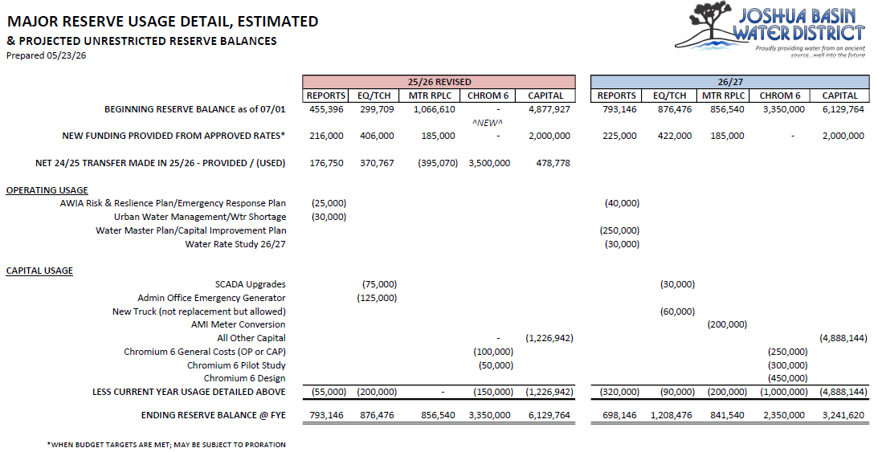
PROJECTED RESERVE USAGE AND BALANCES
Reserve funding requires meeting all budget/rate study targets. May be subject to proration.
Refer to Page 354 of the Agenda packet.

Slide 26
BOTTOM LINE /
FINAL THOUGHTS

Slide 27

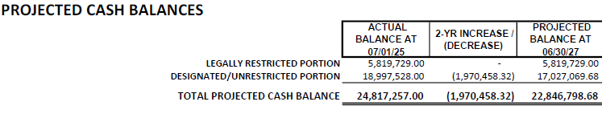
CASH RESERVE BALANCE PROJECTIONS*
* Projected cash balances may be conservative because this analysis starts from budget assumptions instead of current cash position, which is presently exceeding projections.
Refer to Page 340 of the Agenda packet.

Slide 28
COMBINED TOTAL
Operating and Cash Flow reserves are projected to cover six months of Operating expenses, as required by the Reserve Policy.
Refer to Page 340 of the Agenda packet.

Slide 29
BOTTOM LINE & KEY TAKE-AWAYS
25/26 REVISED
26/27 PROPOSED
Net revenues of $1,848,275
Drawdown of $3,818,733
TWO YEAR RESERVE IMPACT PROJECTION:
Cash reserves decrease by $1,970,458 to $22,846,799 ($17,027,070 unrestricted) by 06/30/27
KEY TAKE-AWAYS ABOUT COMBINED BUDGET
Increased reserve reliance to fund capital initiatives
Total expenditure growth outpaces operating revenue growth
Long-term funding strategies for major capital obligations will include rate adjustments and seeking earmarks, grants, and loans.
Refer to Page 340 of the Agenda packet.

Slide 30

Staff recommends adopting the
2025/26 Revised Budget and 2026/27 Proposed Budget.
STAFF RECOMMENDATION

Slide 31


QUESTIONS

