Slide 1
JBWD Board Meeting 12/17/25

Slide 2
Agenda
7B. METER CONNECTION COST ESTIMATE UPDATES
NOTICE OF PRE-APPROVED RATE AND GUARANTEE DEPOSIT ESCALATIONS & PRE-APPROVED CAPACITY CHARGE ESCALATIONS
7C. Rate SCENARIO analysis
7D. NOTICE OF PREVIOUSLY APPROVED RATE AND GUARANTEE DEPOSIT ESCALATIONS AND PREAPPROVED CAPACITY CHARGE ESCALATIONS

Slide 3
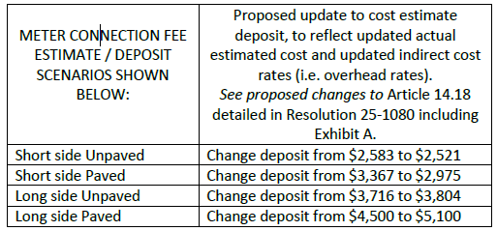
7B. METER CONNECTION COST ESTIMATE UPDATES REFER TO BOARD TO APPROVE RESOLUTION 25-1080
Refunds will be provided if cost estimate exceeds actual cost or bills will be sent if actual cost exceeds cost estimate.
Other size Meter Connection Fees will be calculated and costs estimated individually based on cost of service.
Resolution 25-1080 provides means for GM to update Rules & Regs with new cost estimates based on recent data each year to eliminate excessive resolutions.
See page 22

Slide 4

WHY BRING the rates TO THE BOARD for informational purposes?
The lower, Scenario C rates on the upcoming slides were approved by the Board in 2023 after a Proposition 218 process.
For transparency, the District is publishing these rates once again as advanced notice to the ratepayers. Such notice could alternatively be via billing insert or letter.
In 2023, there was concern over whether the lower rates in Scenario C would be sufficient as they did not fully fund the Capital Improvement Plan (CIP).
However, this rate “deficiency” has been somewhat offset by unforeseen deferred projects and staffing vacancies, resulting in overall “savings.”
While what has occurred is not sustainable, it is an opportunity to gather otherwise unavailable reserves towards the immense forthcoming Chromium 6 project.

Slide 5
7C. RATE SCENARIO ANALYSIS
FOR INFORMATION ONLY: Continue with the Scenario C rate increases in January 2026 as planned.
Consistency is more important than ever as we anticipate having lenders looking at our history of rate changes.
Fiscally strong year but unsustainable factors:
Rate Study: January 2025 increases were deferred until July 2025, resulting in revenue loss of appx. $290k of projected increases.
Operating Revenue Growth: Increased 8.02% or $724,593 for FY 2024/25 generating $2.783 reserve set aside for CIP work, future equip. replacement, etc. for the last few years. This reserve set aside was intentionally included in the Rate Study but went largely unused due to unforeseen circumstances.
Factors of Operating Revenue Growth: Scheduled increases, small customer base growth (25), 44,455 units (9.63%) increase in consumption. [In the audit meeting, I discussed 1,306 as the number of increased units in error. Discussion was incorrect but the audit document is correct].
Unrestricted Cash Balances: Unrestricted/Designated Cash balances have increased by $11.15 million since 2019/20 [not since rate study data collection in 2021/22 as original agenda stated] average of $2.2 million a year due to deferred capital spending, staff vacancies, higher property tax revenues, and record-high interest earnings.
Net position grew by 9% or $4.629 million, exceeding expectations in this unusual year.
See pages 28-30

Slide 6
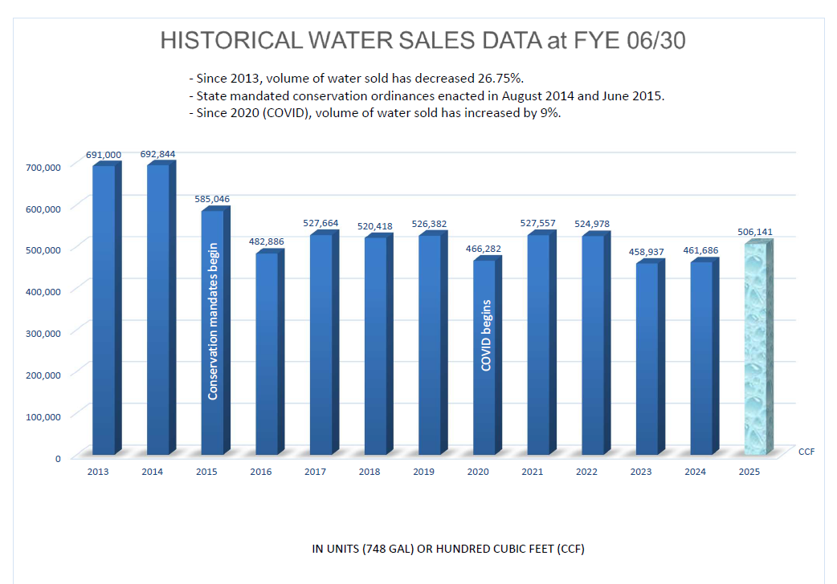
FOR REFERENCE
Not in packet

Slide 7

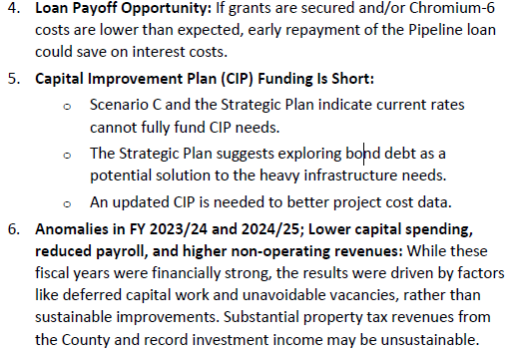
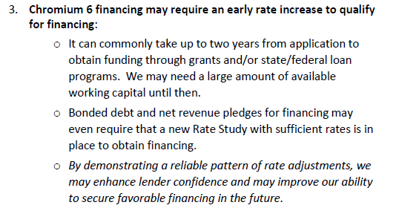
7C. RATE SCENARIO ANALYSIS, cont’d
FOR INFORMATION ONLY: Continue with the Scenario C rate increases in January 2026 as planned.
Consistency is more important than ever as we anticipate having lenders looking at our history of rate changes.
See pages 28-30

Slide 8
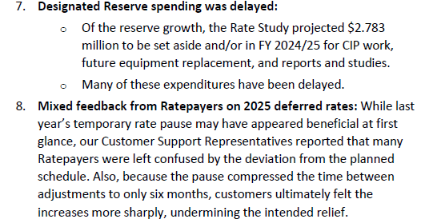
7C. RATE SCENARIO ANALYSIS, cont’d
FOR INFORMATION ONLY: Continue with the Scenario C rate increases in January 2026 as planned.
Consistency is more important than ever as we anticipate having lenders looking at our history of rate changes.
9. Ten-year projection:
A 10-year financial projection with Ridgeline
Municipal Strategies is underway for use with Chromium 6 financing.
Maintaining consistency with the adopted rate structure is essential to producing a reliable model—one that will guide the next rate study and serve as a critical reference for credit rating agencies and potential lenders. Stability and predictability in our data not only strengthen the accuracy of long-term planning but also reinforce the District’s financial credibility.
See pages 28-30

Slide 9
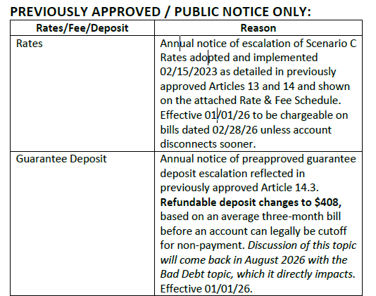
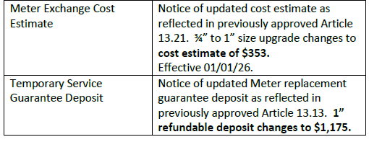
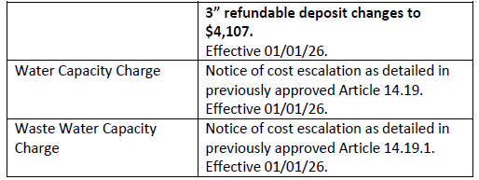
7D. NOTICE OF PRE-APPROVED RATE AND GUARANTEE DEPOSIT ESCALATIONS & NOTICE OF PRE-APPROVED CAPACITY CHARGE ESCALATIONS FOR INFORMATION ONLY
See pages 31-32

Slide 10
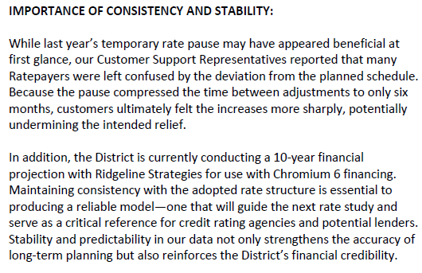
CONSISTENCY AND STABILITY
See page 32

Slide 11
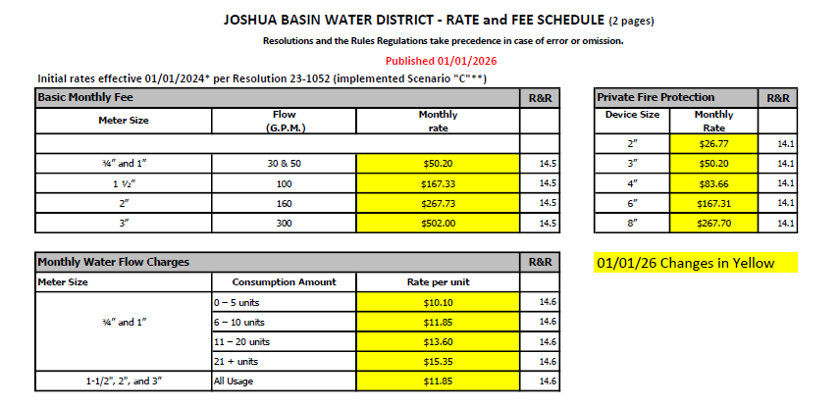
EXCERPT FROM RATE SCHEDULE
See page 33

Slide 12
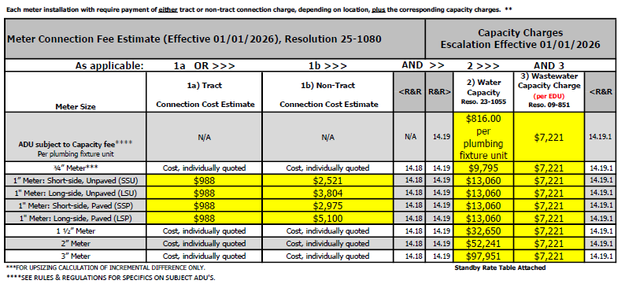
EXCERPT FROM RATE SCHEDULE, cont’d
See page 34

Slide 13
Questions?
Thank you!

