Slide 1
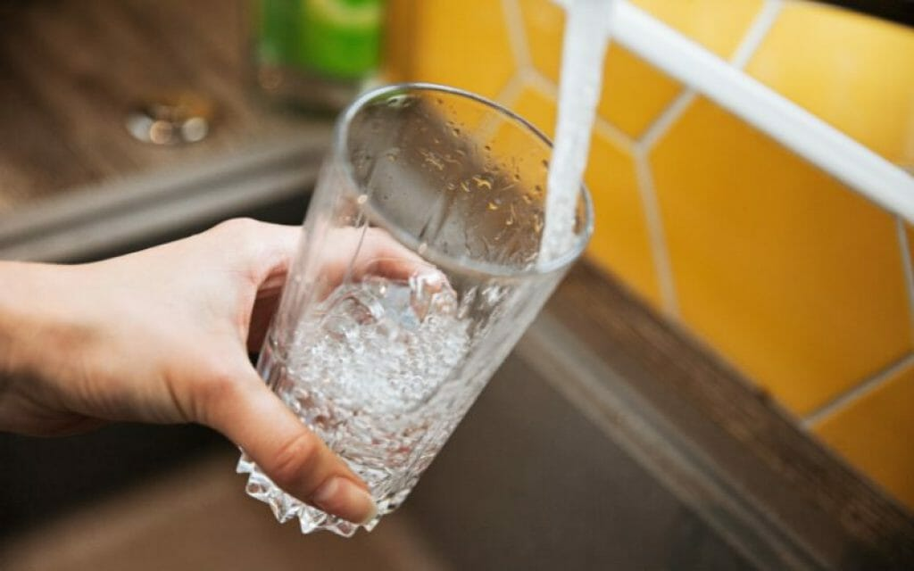
An Exploration of Nitrate Levels in Joshua Basin Water District Production Wells
---
Monday 09/28/2026
Brian G. Hammer Sr
Principal Data Analyst
Hammer Analytix

Slide 2

About Today's Presentation

Slide 3

Areas We Will Explore
Background on water
  Other stuff in water besides water
  Water is safe to drink here and in all public water supply’s in California
  Stiff Diagrams, Water’s fingerprint
  State Well Numbers
About Nitrates
TL;DR (Too Long Didn't Read)
Groundwater Basins
JBWD pumping
JBWD Recharge Efforts
Area Water Levels
The Effects of Recharge
Stiff Diagrams
Nitrates Well by Well
The Sources of Nitrates
Conclusions
Recommendations

Slide 4

Some Background on Water Part I
Water always has constituents or contaminates
Some are natural, some anthropogenic (placed there by humans)
Amounts determine if water is safe to drink or even use
Alternative is distilled water that lacks minerals we may need such as calcium and magnesium
Maximum Concentration Levels (MCL’s) are established by doctors, scientists, and regulators to ensure we have safe water
Standards are regulated by California EPA and the Federal EPA
Standards are based on… Can a human consume two liters per day for 80-years without any ill health effects?
MCLs: https://www.waterboards.ca.gov/drinking_water/certlic/drinkingwater/documents/mclreview/mcls_dlrs_phgs.pdf

Slide 5

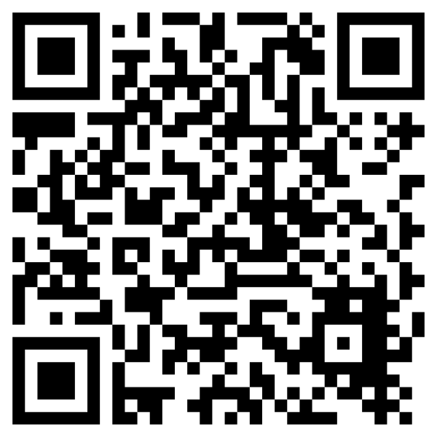
Some Background on Water Part II
About Title 22 and Consumer Confidence Report’s (CCR)
Anywhere the public drinks water that water is tested regularly for 100 to 120 different constituents, certified lab results are sent separately and securely to the purveyor and the California Division of Drinking Water (DDW)
Those tests cost thousands of dollars per sampling event
We have very safe water in California despite what roving (untrained) people in big-box stores might imply or say
All water quality results you will see today are from CA DDW or the USGS
If you want to find out more on how California insures all water in public spaces is safe to drink, please follow this
QR code.

Slide 6
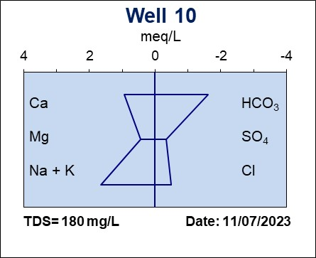
Some Background on Water Part III
What is a Stiff Diagram?
Waters fingerprint!
This allows for a rapid visual comparison of water from multiple sources
Cations
Anions
Calcium
Bicarbonate
Magnesium
Sulfate
Sodium +
Potassium
Chloride
Total
Dissolved
Solids
Sample
Date
Later in this presentation this will help show which production
wells are pumping out of the same groundwater basin

Slide 7
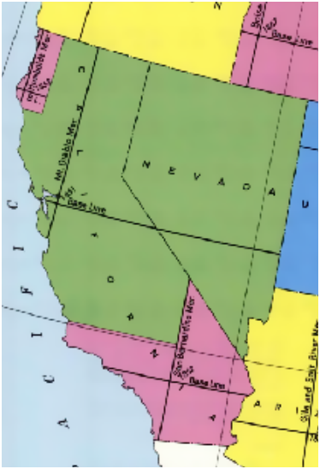
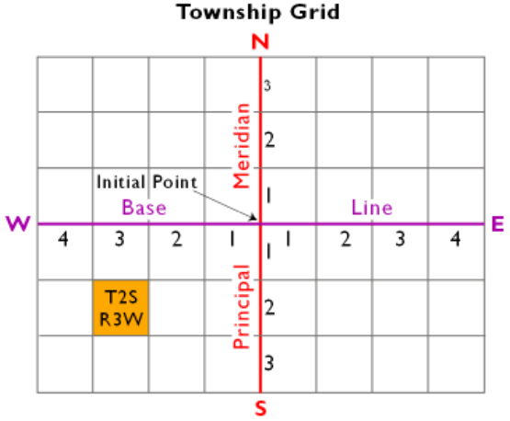


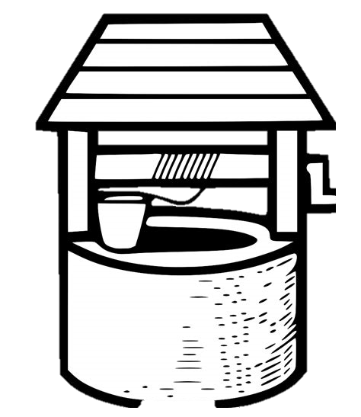
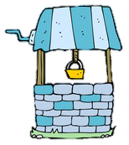
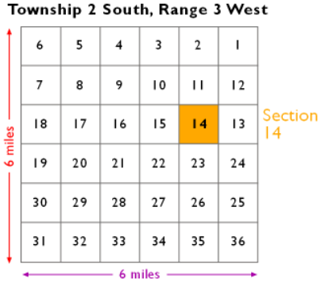
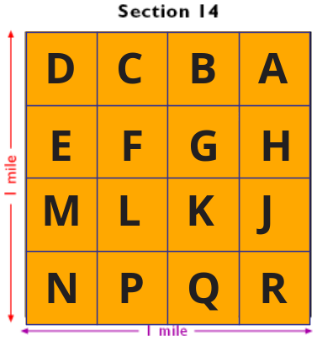
How are Wells Identified Part IV
Township & Range
6-mile
squares
Tract
¼ -mile/sq
AKA quarter-quarter
State Well Numbers are issued by DWR or in our area MWA
They are based on the Public Land Survey System (PLSS) and first, second, third in sequence.
Well 03
Well 02
Well 01
First Well
In the Tract
Section
1-mile
squares
02S03W14N01(as an example only)
02
S
03
W
14
C
01
Township
N or S of
Baseline
Range
E or W of
Meridian
Section
Tract
Sequence number in Tract
Later in this presentation this will help with monitoring wells

Slide 8
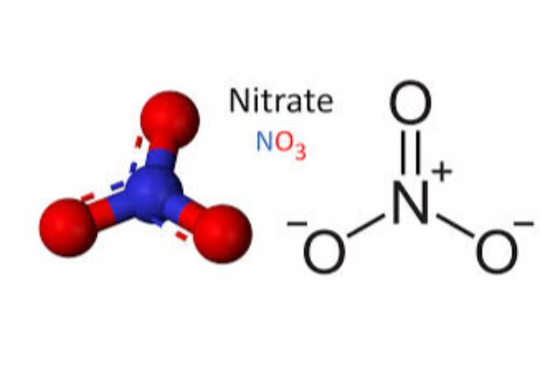
Sources of Nitrates in Drinking Water
Their presence in groundwater is generally associated with:
  Septic systems
  Confined animal feeding operations
  Overuse of fertilizers
  Production of fertilizers
  Production of explosives
  Treated wastewater
  Urban stormwater runoff
  Etc.
https://www.waterboards.ca.gov/drinking_water/certlic/drinkingwater/Nitrate.html

Slide 9
Sources of Nitrates in Drinking Water
Their presence in groundwater is generally associated with:
  Septic systems
  Confined animal feeding operations
  Overuse of fertilizers
  Production of fertilizers
  Production of explosives
  Treated wastewater
  Urban stormwater runoff
  Etc.
https://www.waterboards.ca.gov/drinking_water/certlic/drinkingwater/Nitrate.html

Slide 10
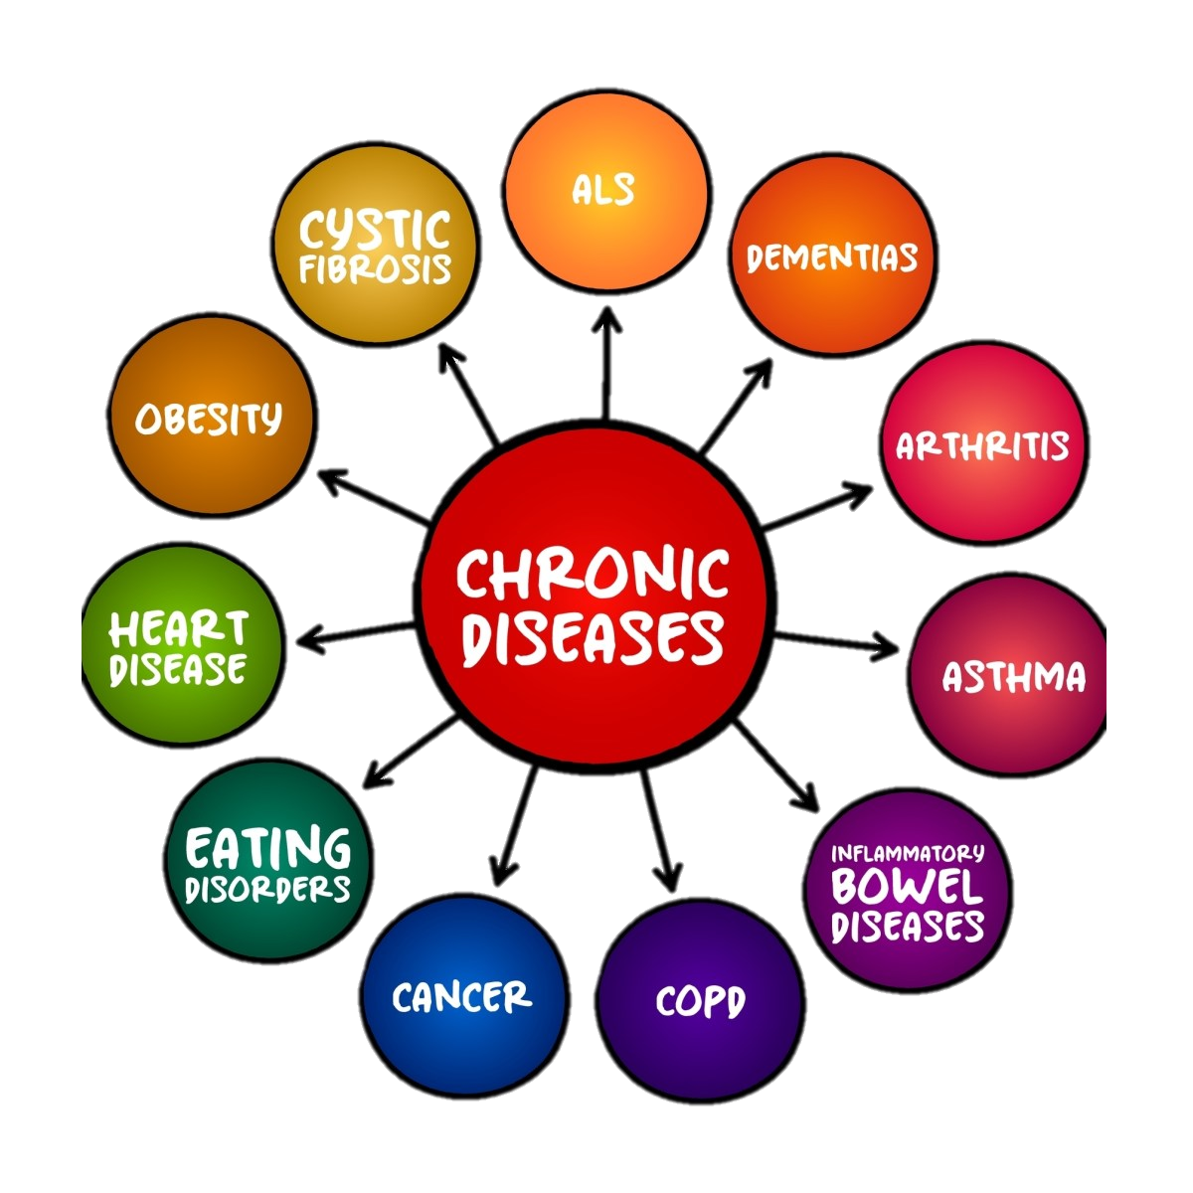


Who is at Risk of High Nitrates in Drinking Water?
Pregnant lady's
Children under 6-months
Some Individuals with health conditions
10

Slide 11
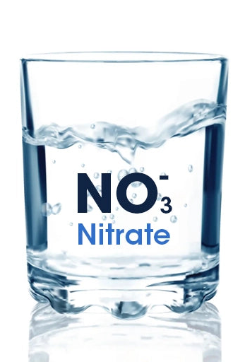
TL;DR
Based on available groundwater-quality and production data, the Joshua Basin Water District (JBWD) does not currently have a nitrate issue in its public-supply wells.
Nitrate concentrations generally do not indicate an immediate water-quality concern. Well 10 shows an increasing trend in nitrogen concentrations over time.
If JBWD can shift production away from Well 10, the available data suggest nitrate impacts can likely be managed without creating a water-supply nitrate problem in the foreseeable future
Data Sources: JBWD, USGS, CA DDW, SBCO

Slide 12
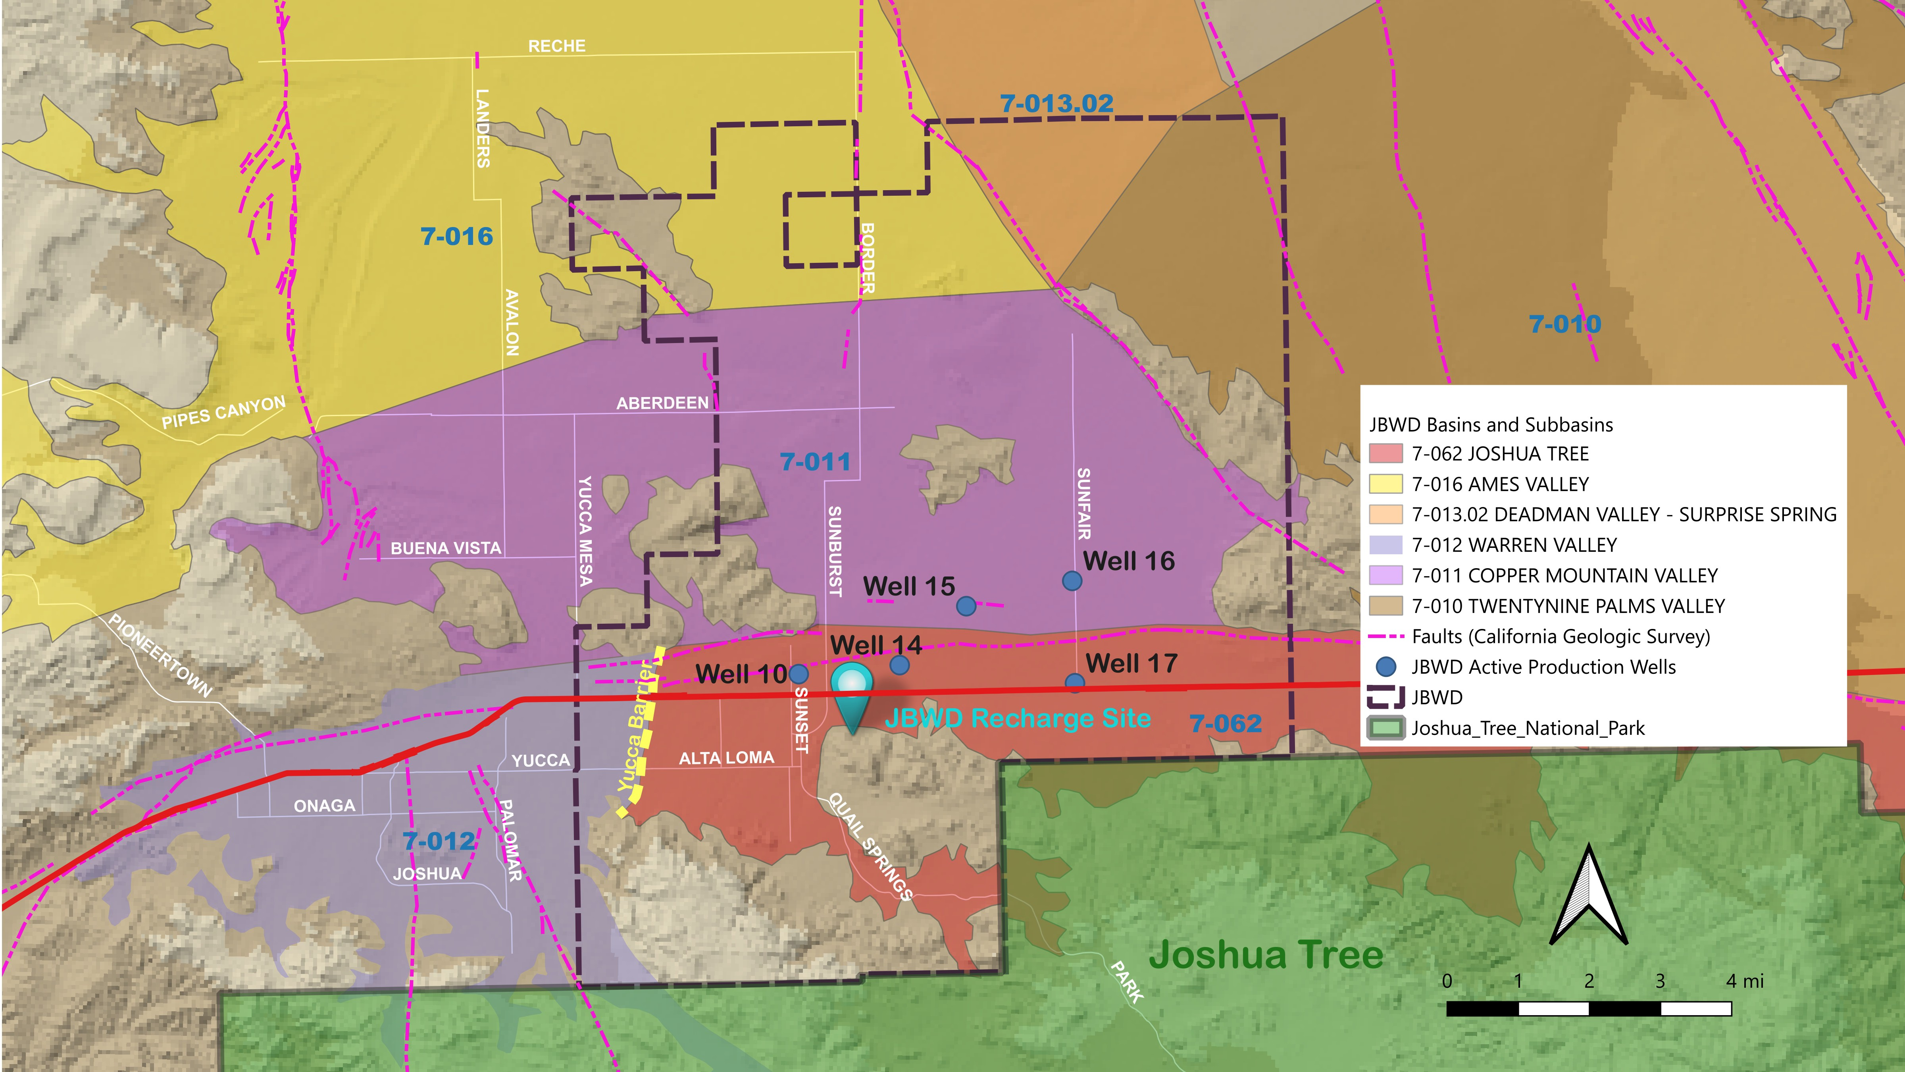
Production Wells, Groundwater Basins, and Recharge

Slide 13
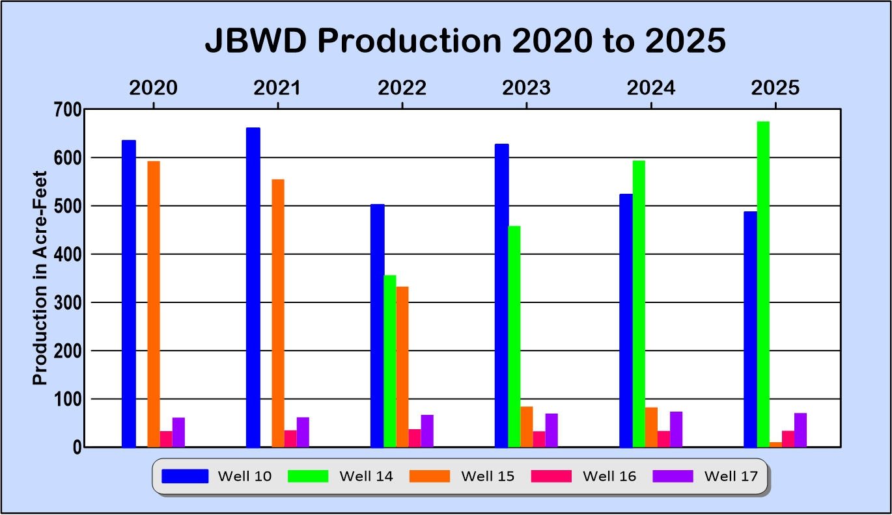
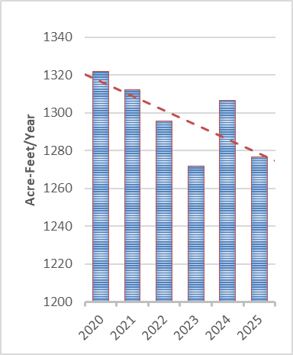
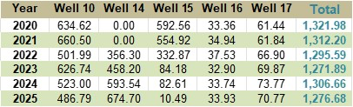
Note: Production Declined 3.54% in the last six years
Total Production
Production
Note: Well 14 was offline in 2020 and 2021. Well 15 was used to satisfy the demand
Data Source: JBWD

Slide 14
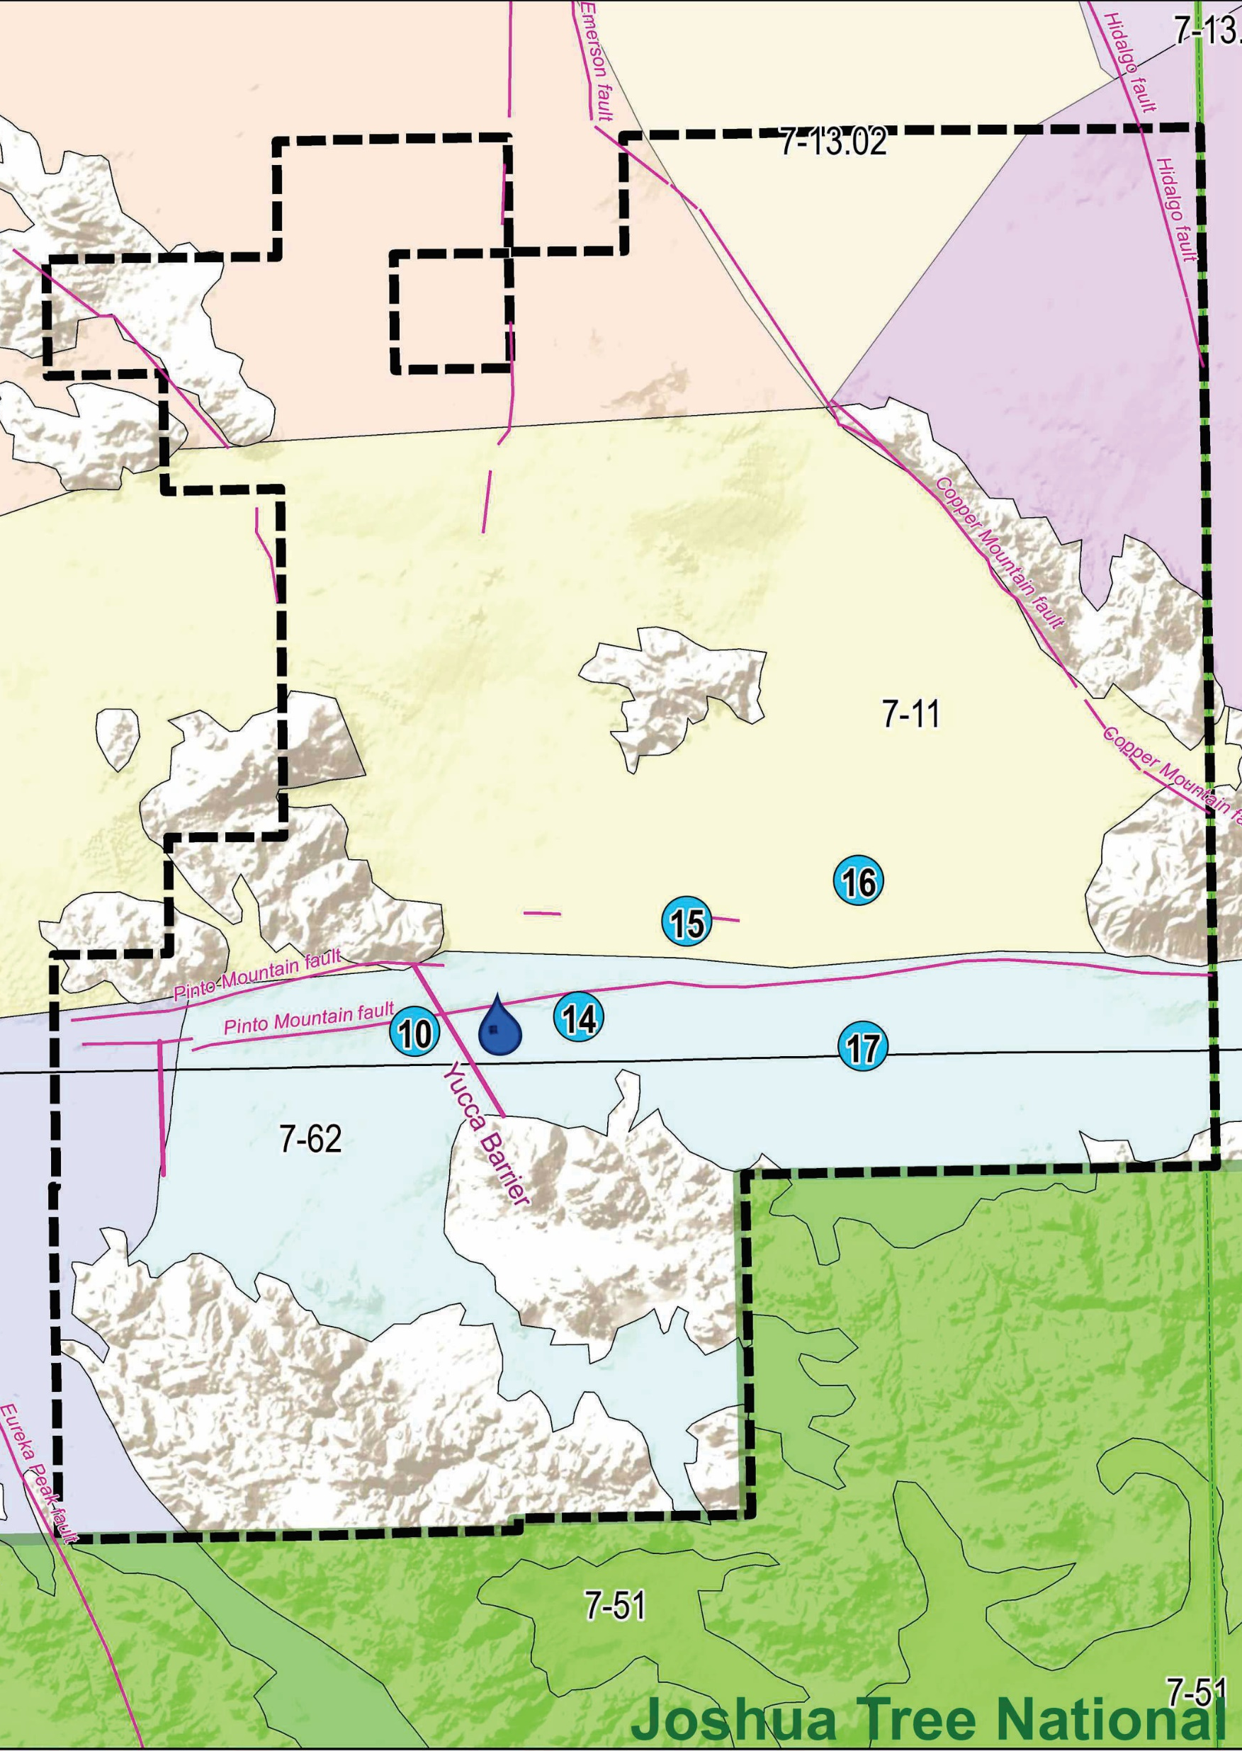
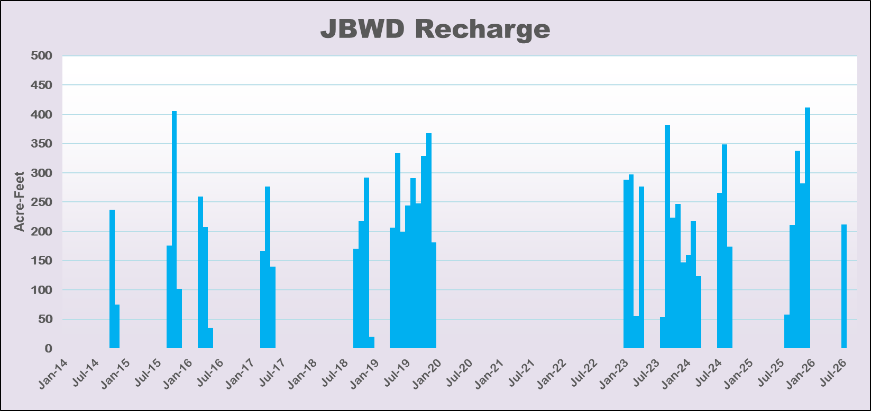
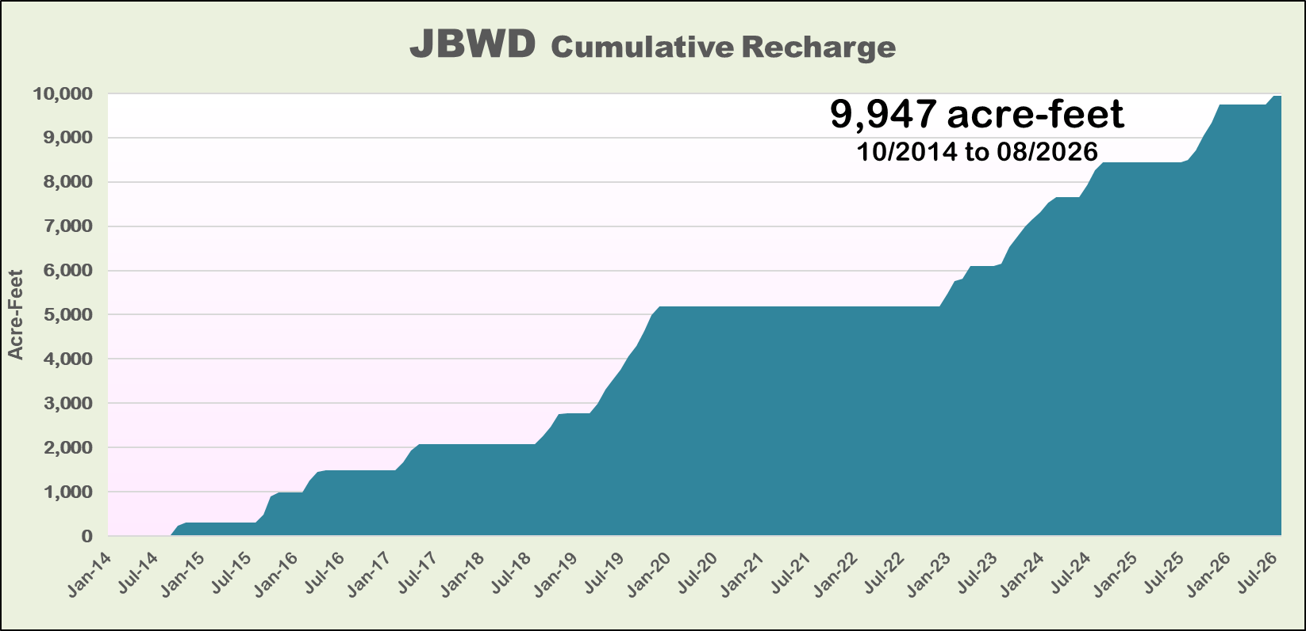
Recharge
Provides
Water
Security
and
Dilutes
Nitrates
Recharge!
Data Sources:
DWR, MWA
JBWD, USGS

Slide 15
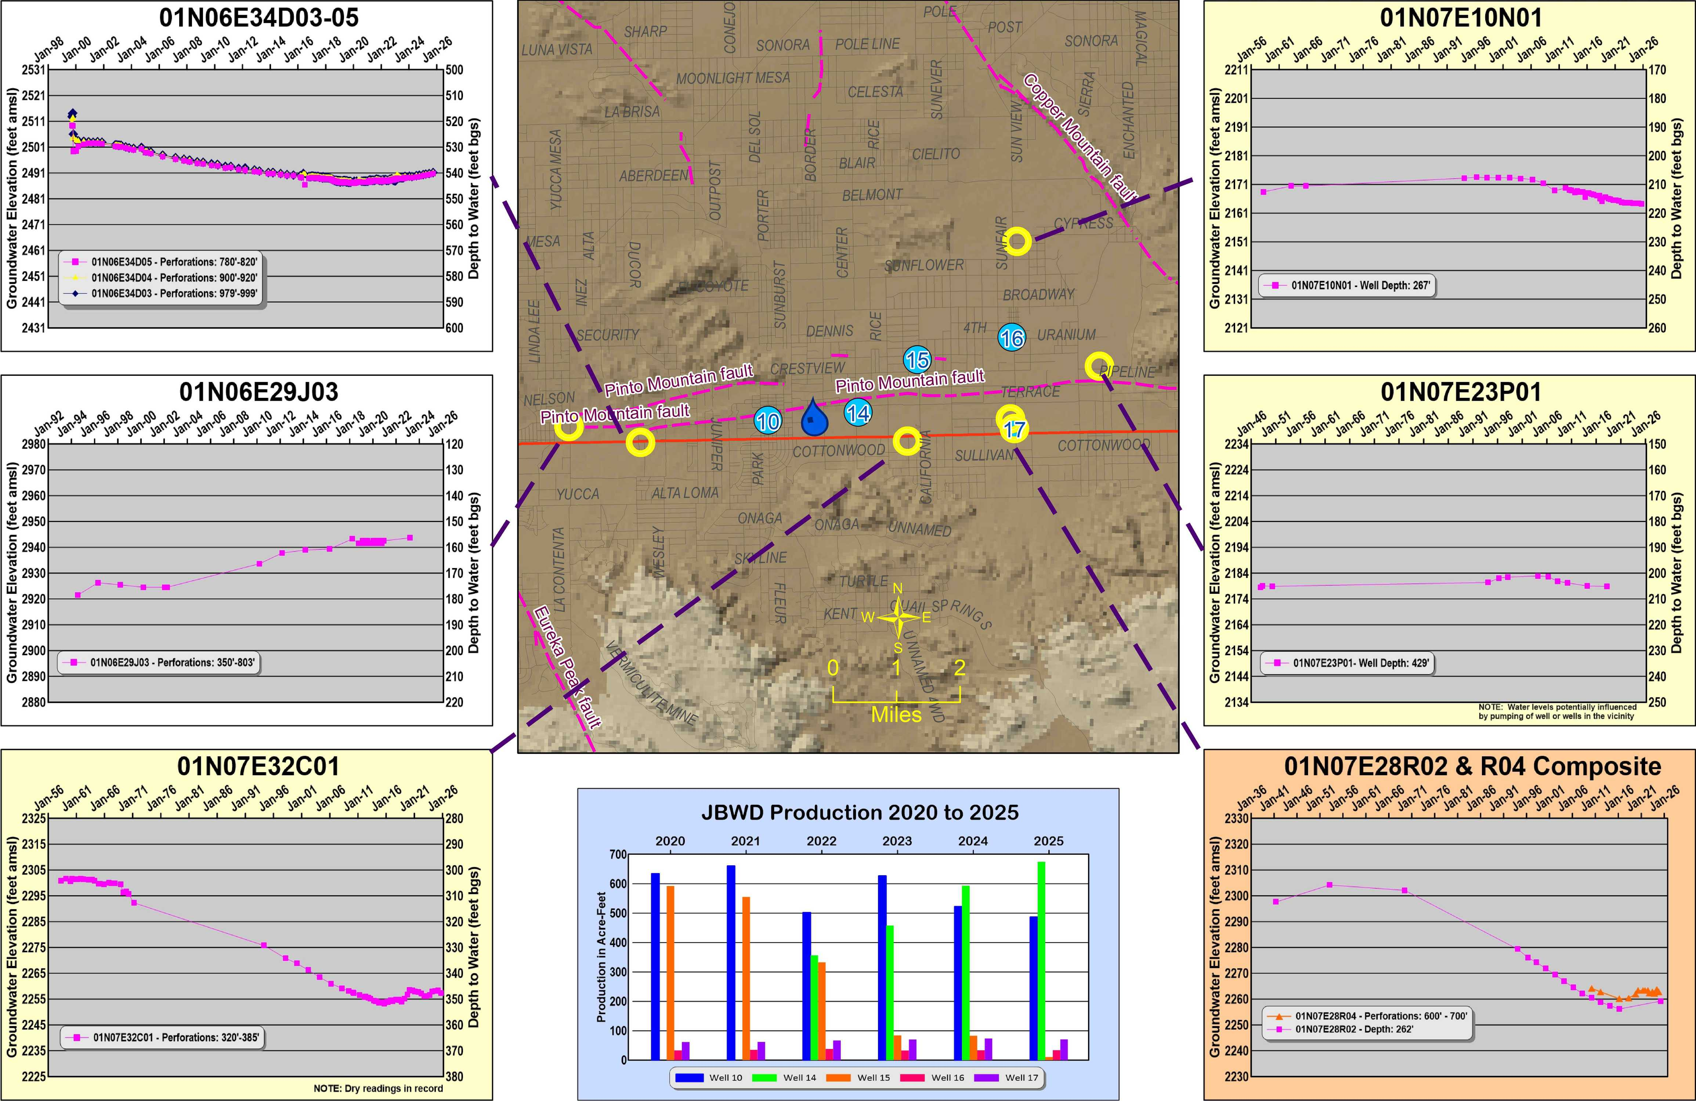
A Tale
Told by
Monitoring
Wells in the
Area
Blue dots are JBWD wells
Yellow Rings
are monitoring
wells
Data Sources:
JBWD, MWA
USGS

Slide 16
Does
Recharge
Work
YES!
Note The
Change
In Slope.
Some Going
Up,
Some Just
Now Turning
Around
Data Sources:
JBWD USGS

Slide 17
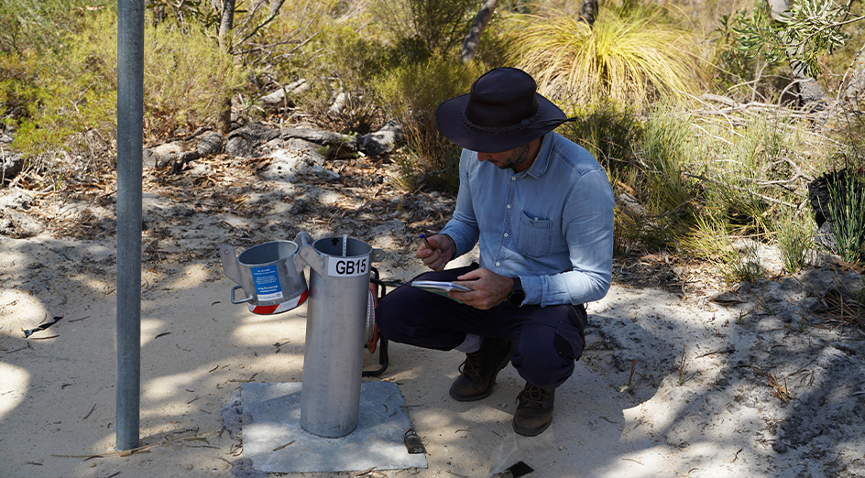
Groundwater Quality

Slide 18
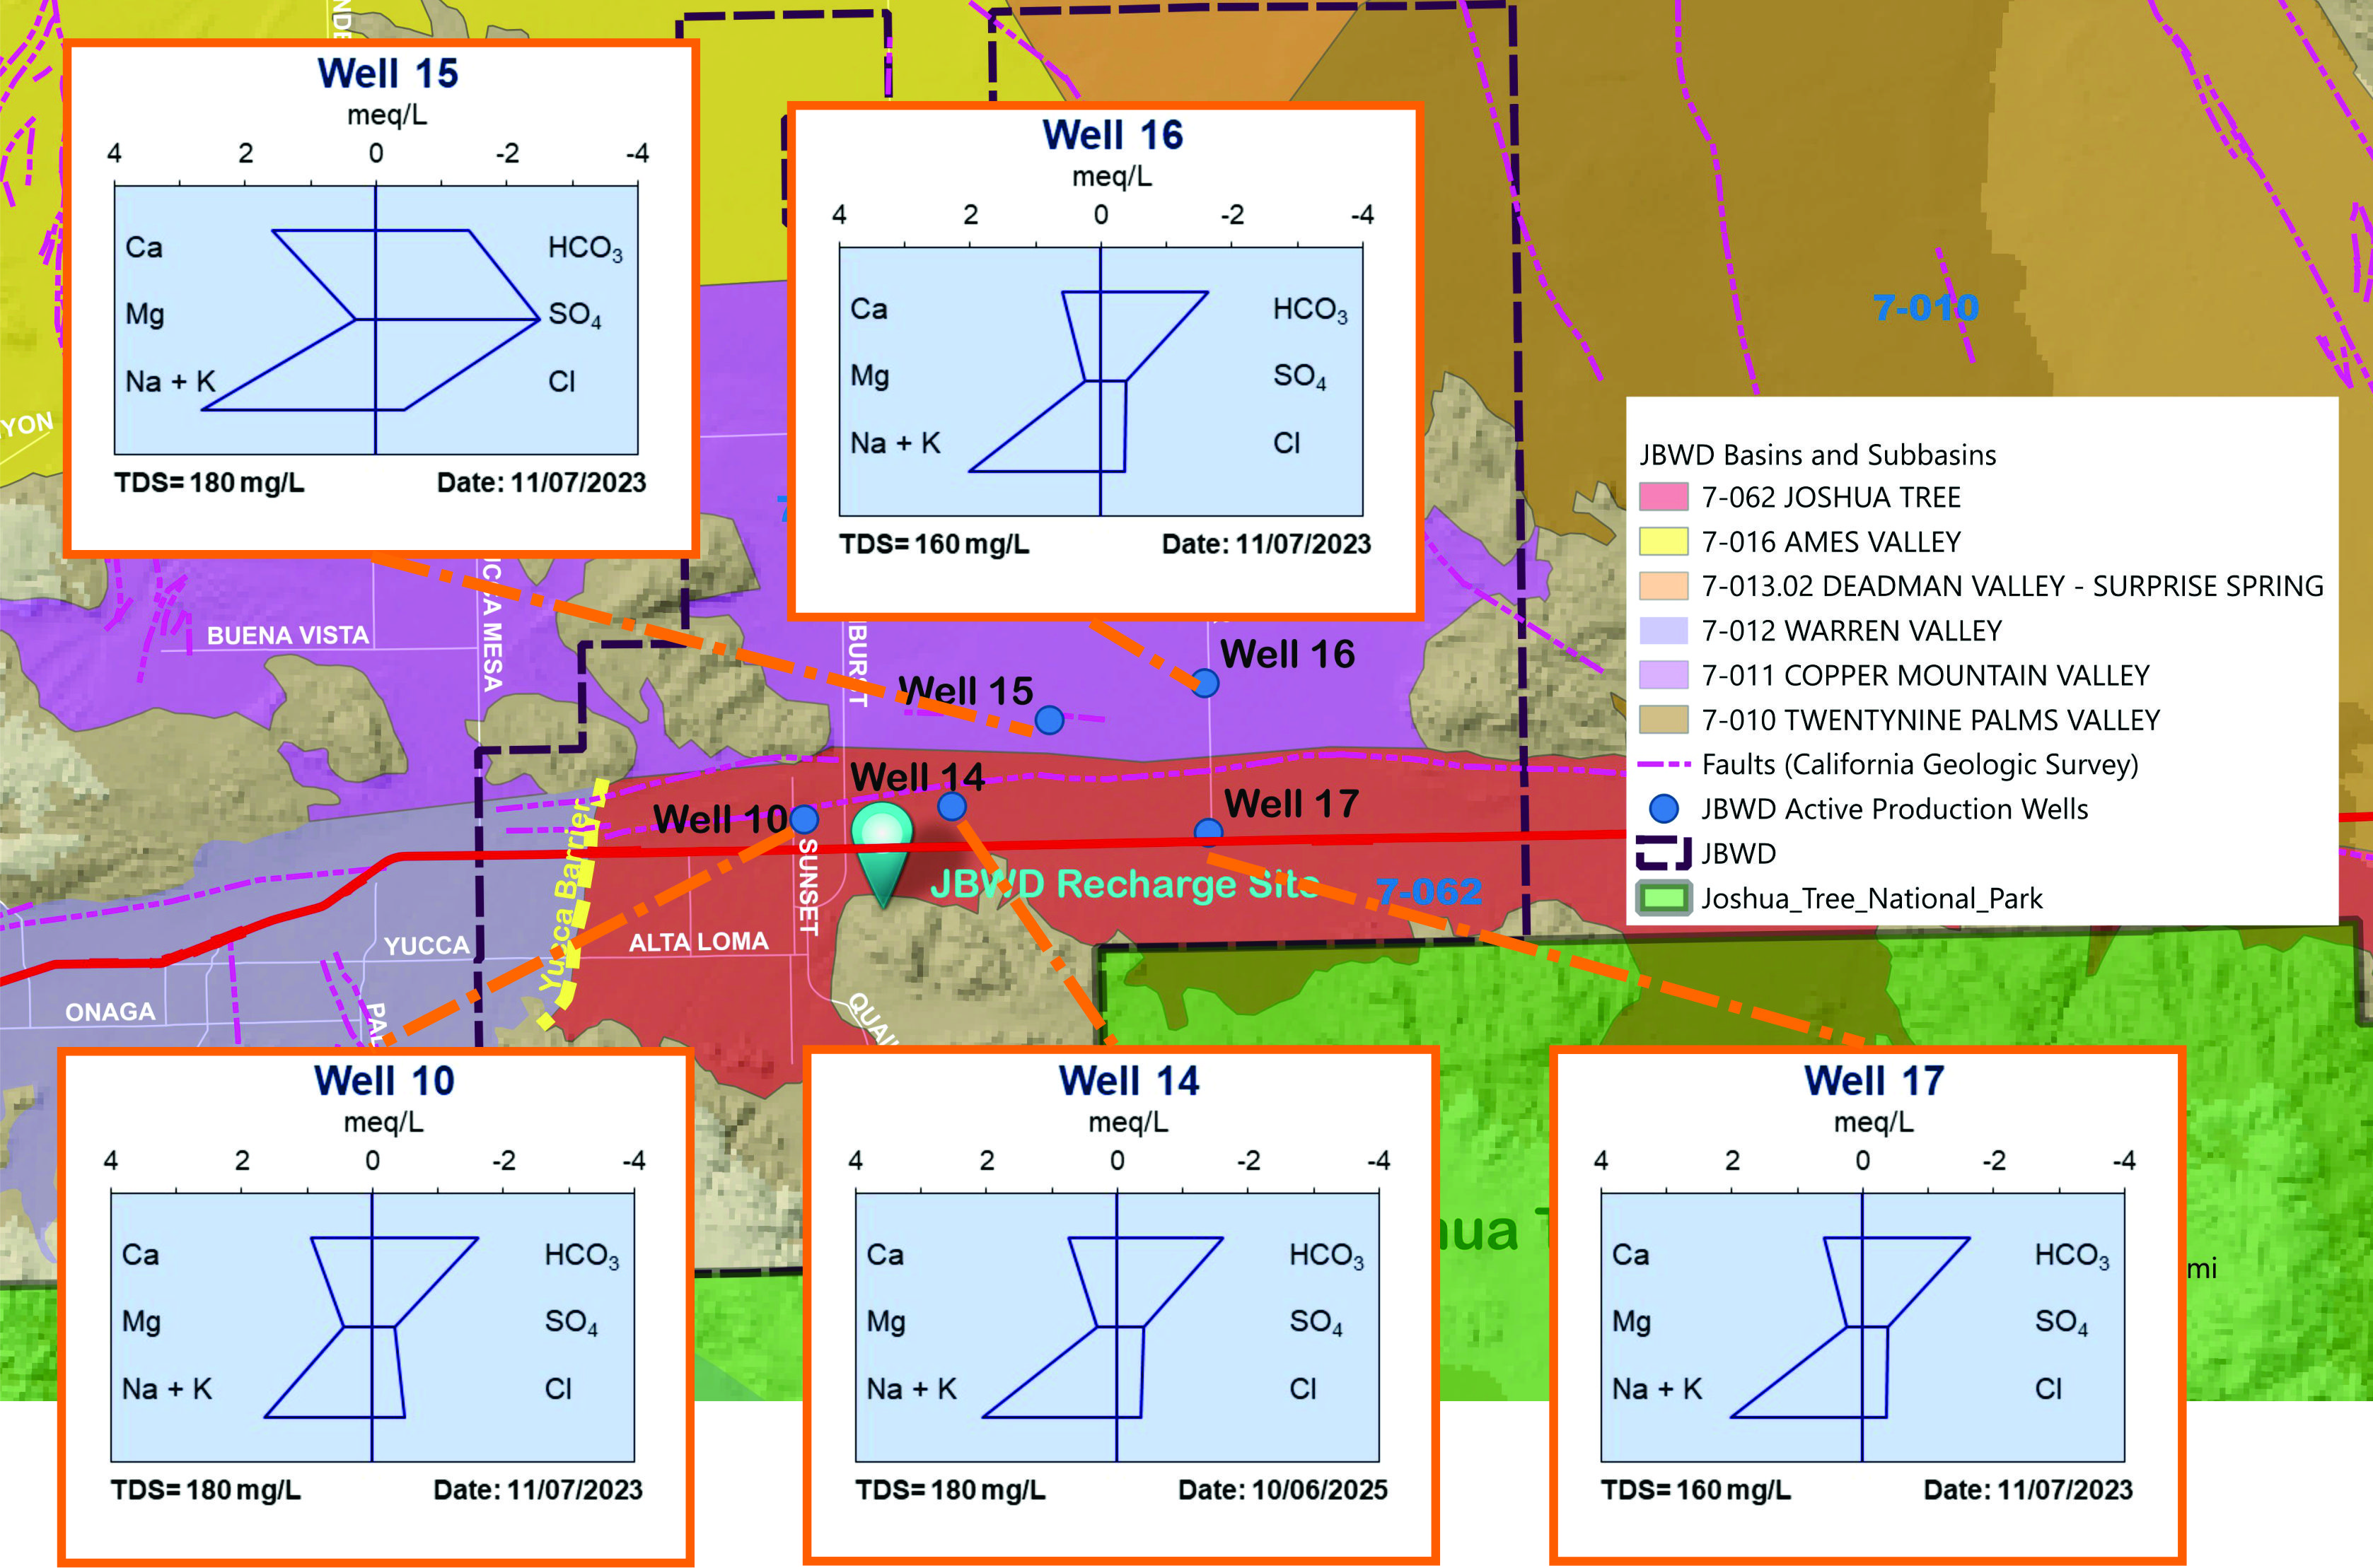
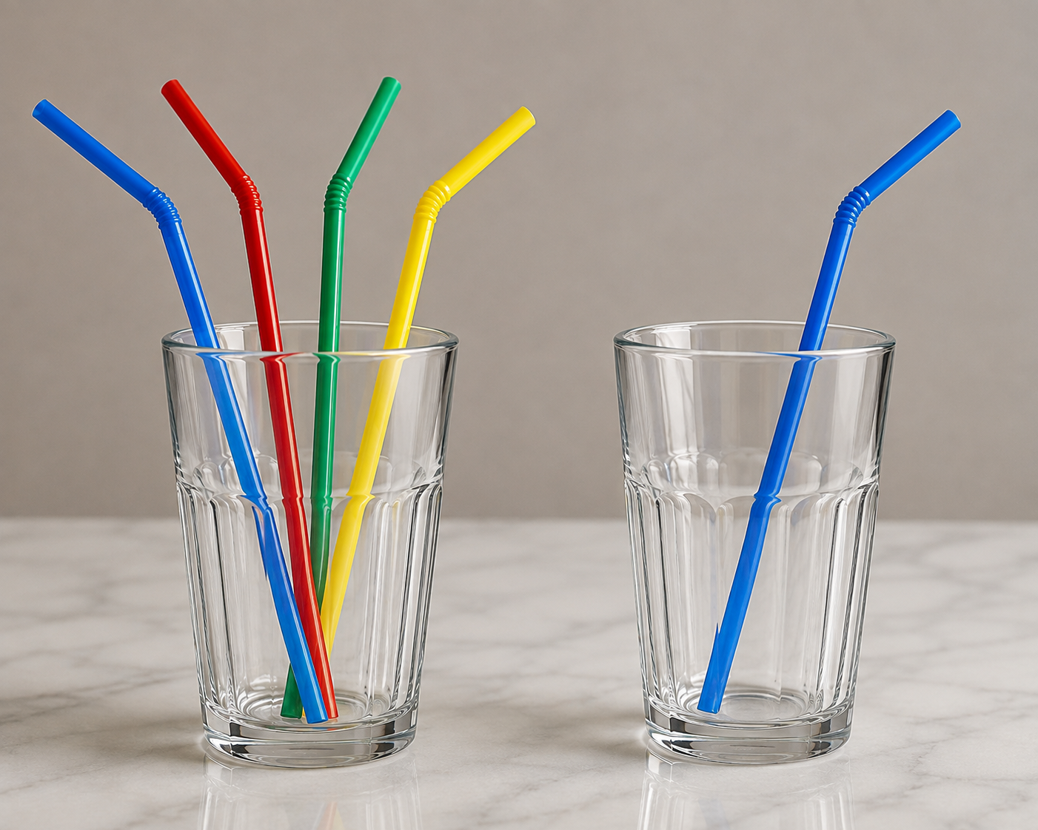
What Story Do The Stiff Diagrams
Tell?
Data Sources: CA Division of Drinking water

Slide 19
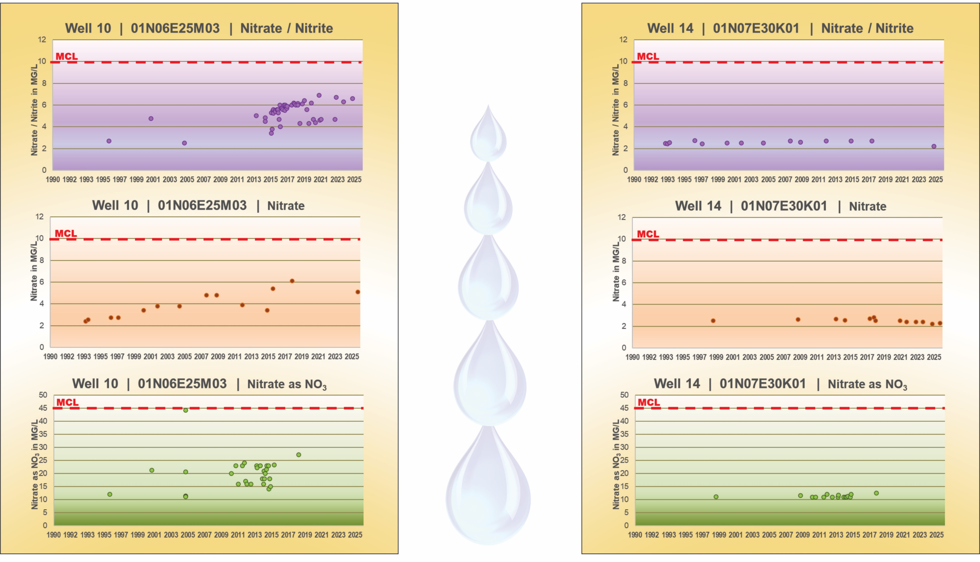
Nitrates over time by well
Part I
10
14
Data Source: JBWD and
CA Division of Drinking water

Slide 20
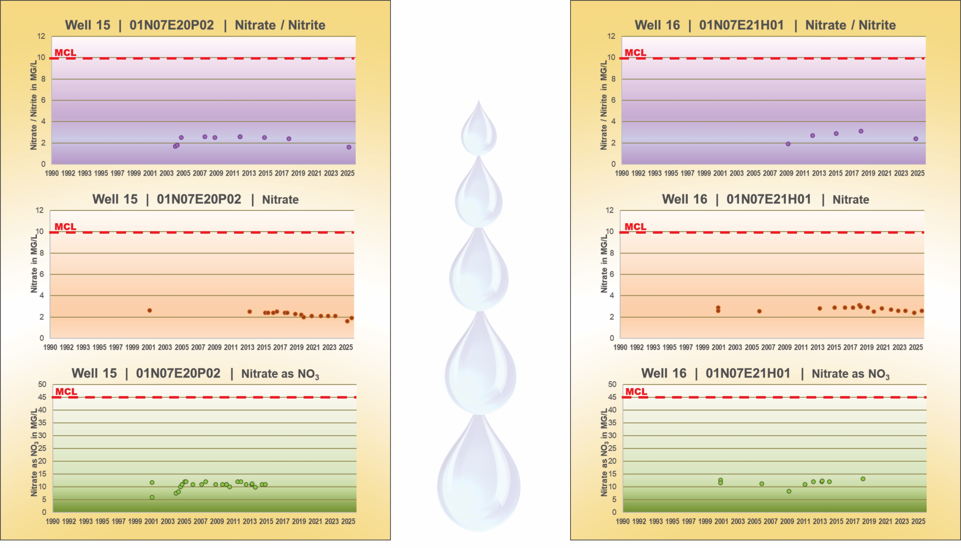
Nitrates over time by well
Part II
15
16
Data Source: JBWD and
CA Division of Drinking water

Slide 21
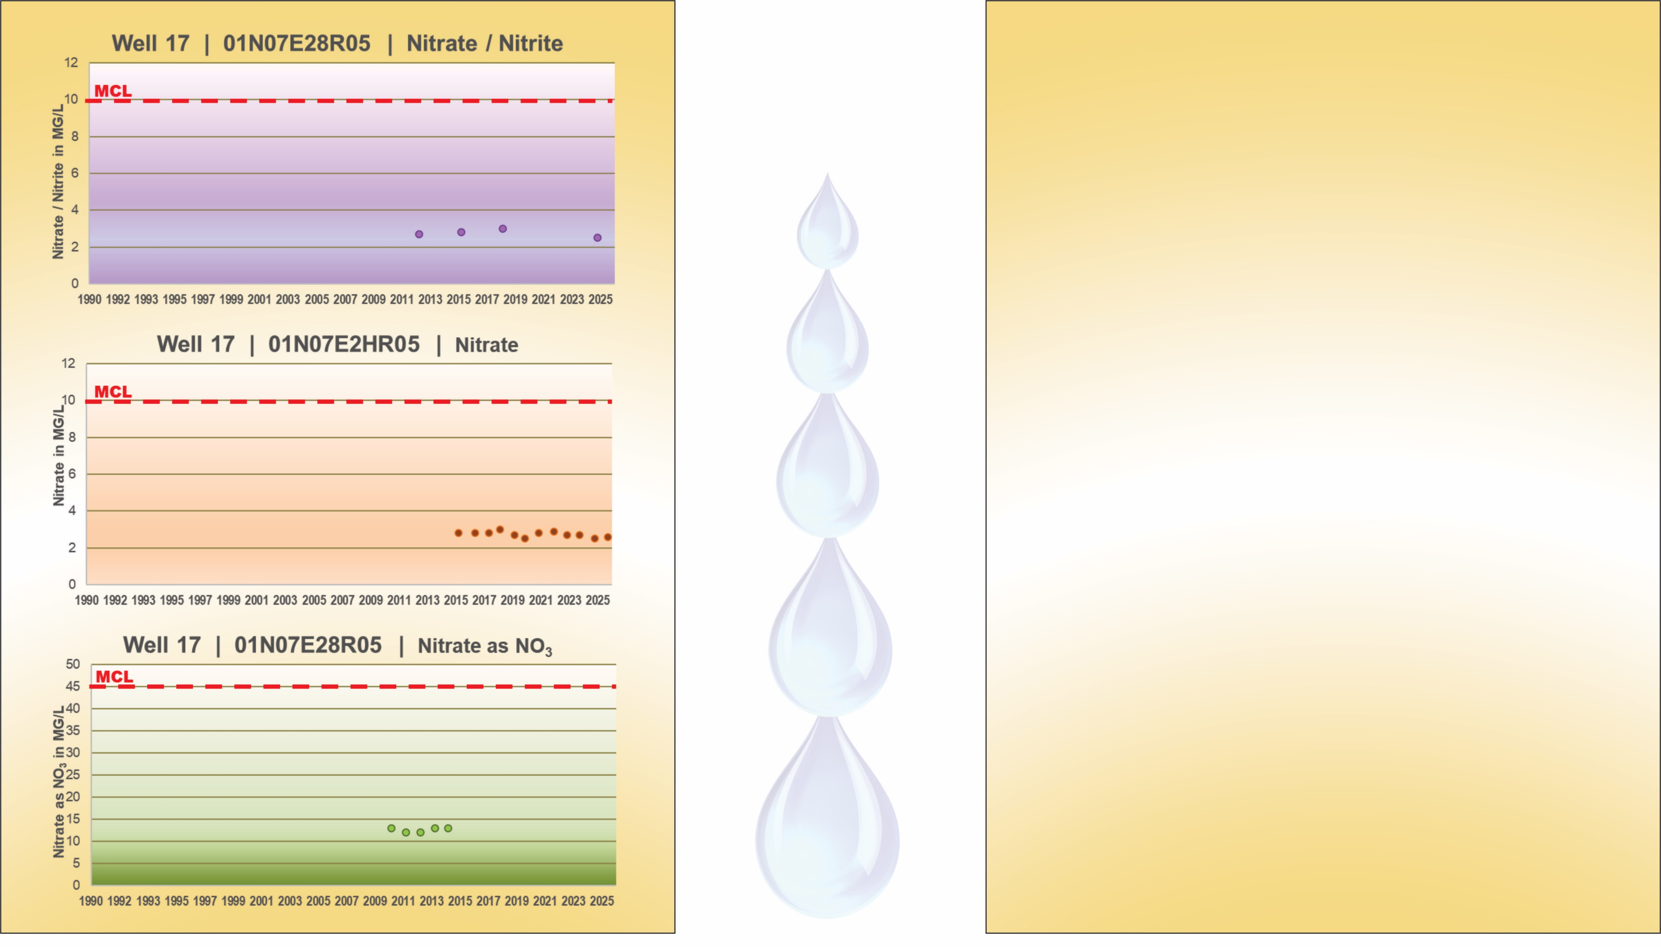
Nitrates over time by well
Part III
17
Data Source: JBWD and
CA Division of Drinking water
21

Slide 22
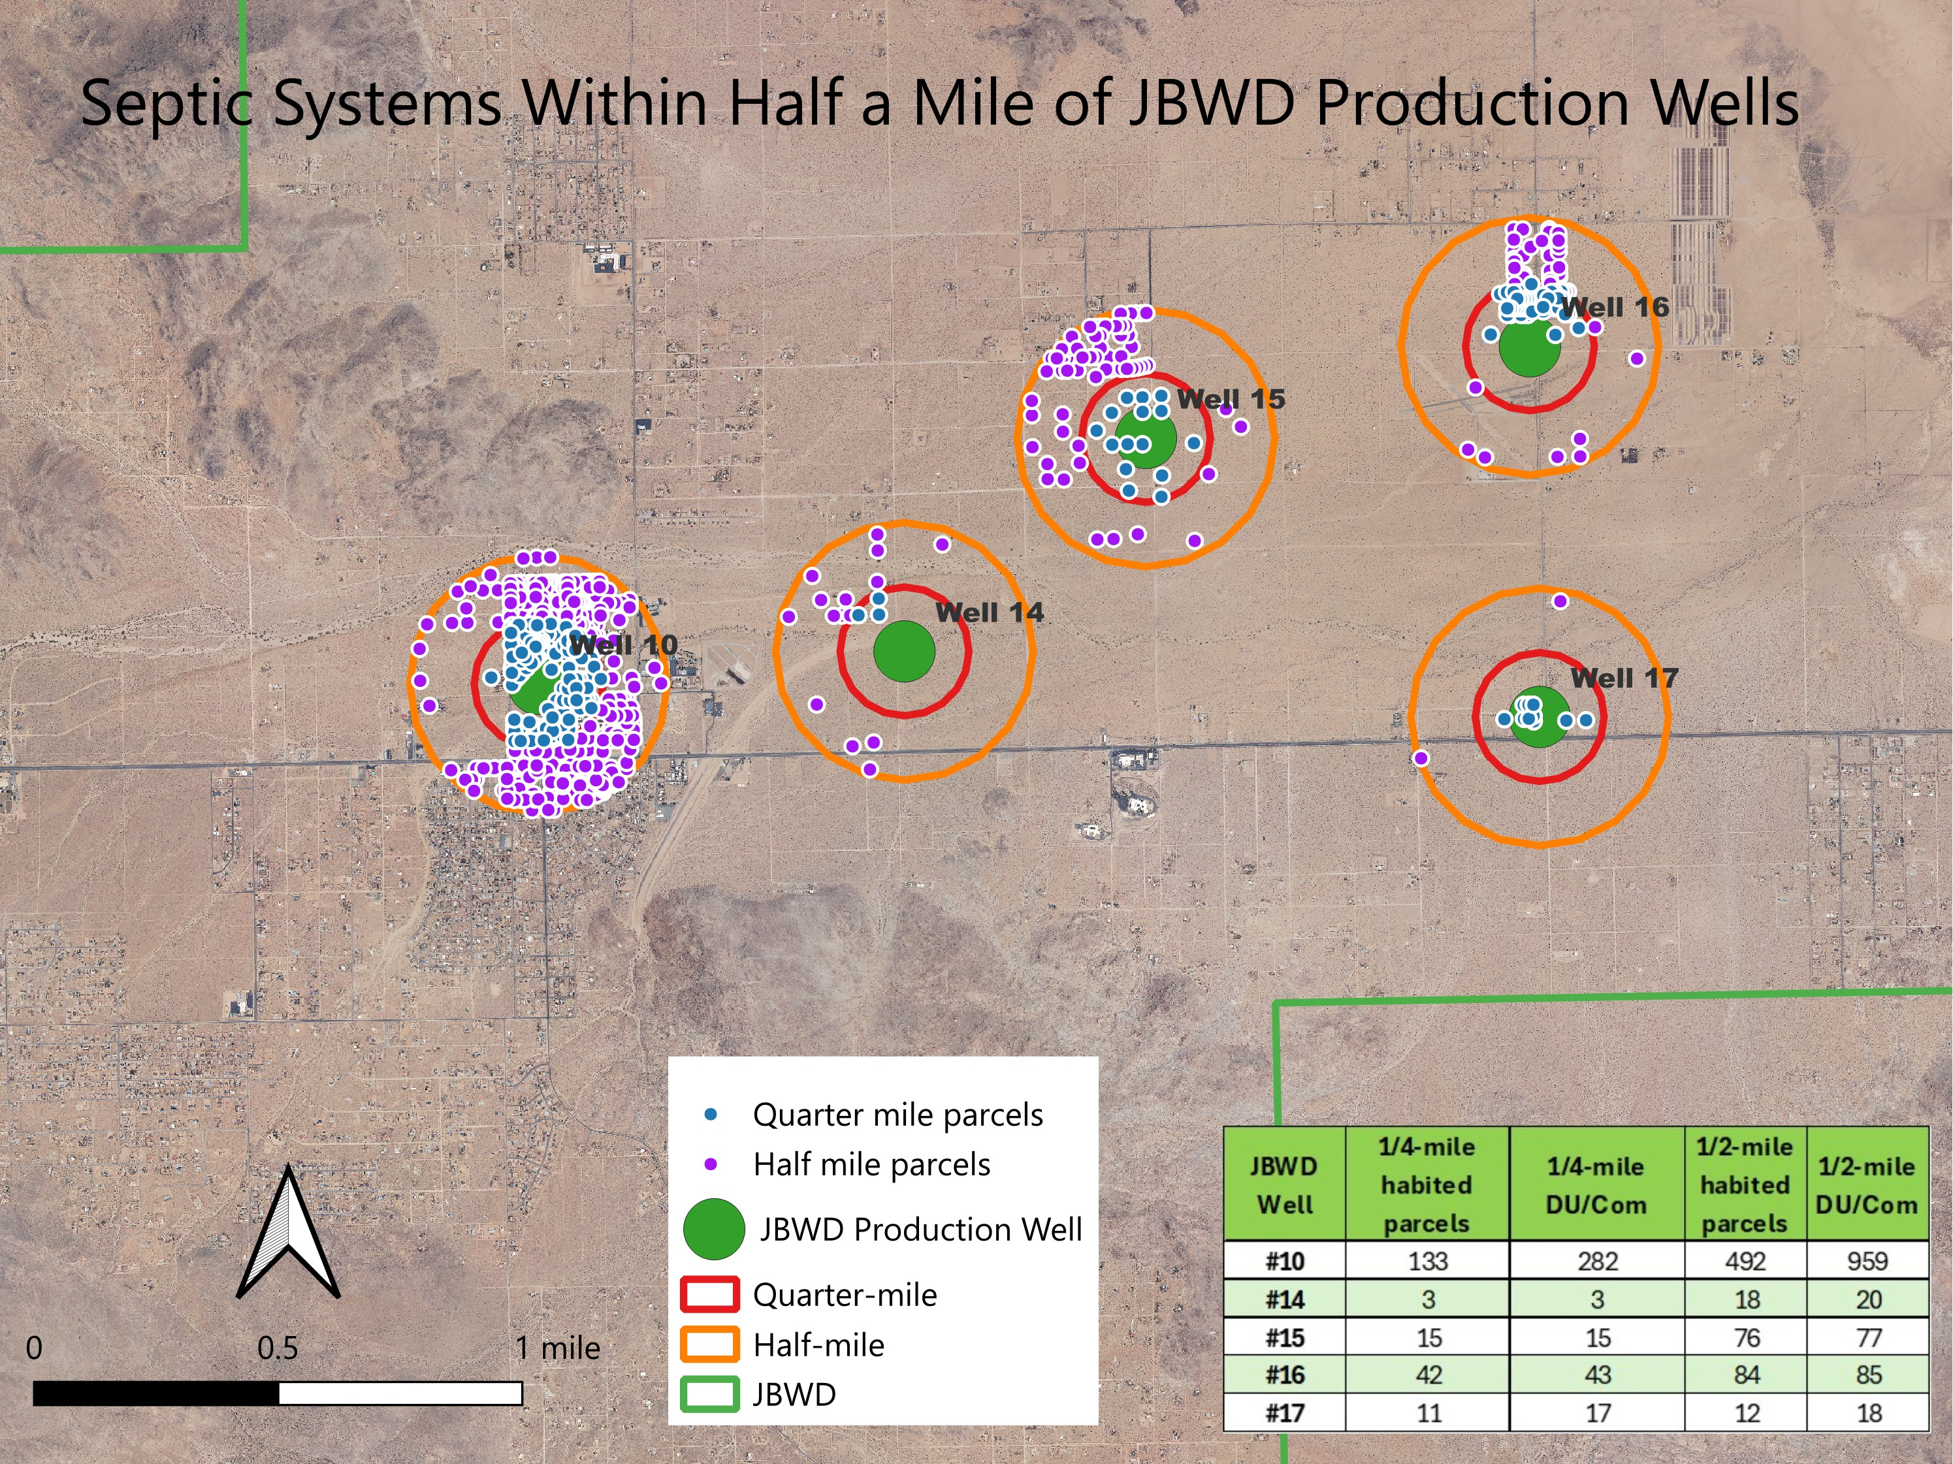

The Likely
Cause of the
Well 10
Nitrates
Data Sources: JBWD,SBCO

Slide 23
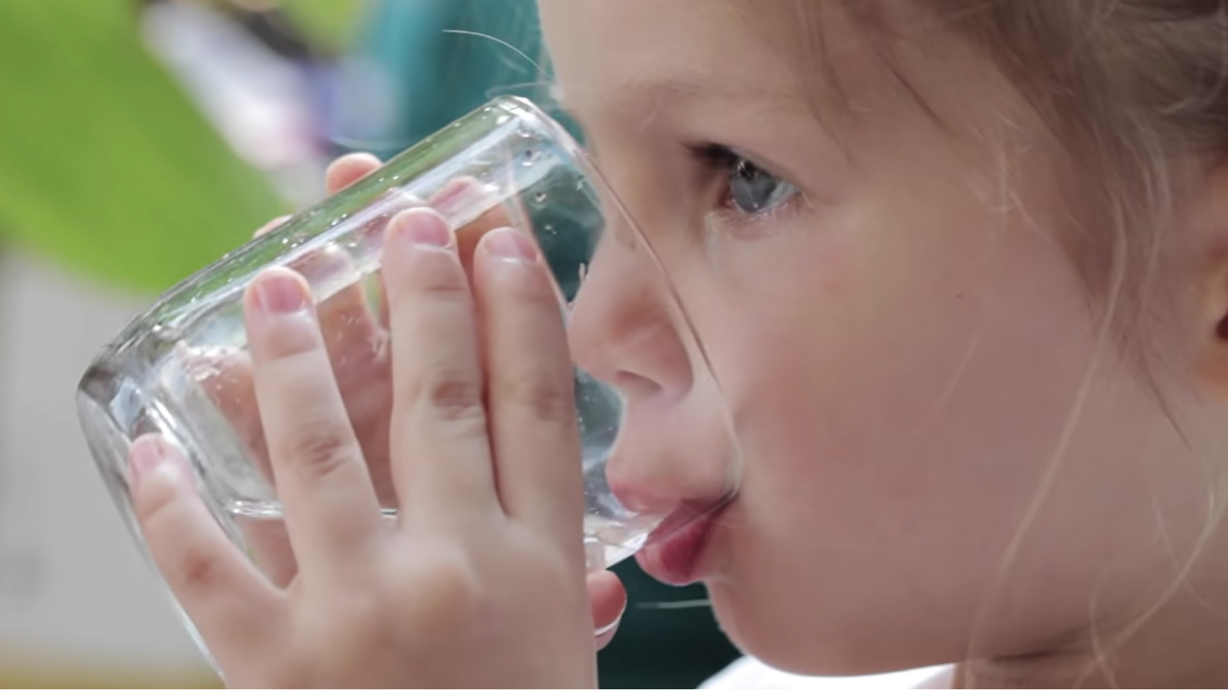
Key Takeaways

Slide 24
Your JBWD Water is Safe to Drink

Slide 25
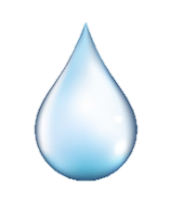
Conclusions
Based on available groundwater-quality and production data, the Joshua Basin Water District (JBWD) does not have a nitrate issue in its public-supply wells.
Nitrate concentrations do not indicate a water-quality concern.
Well 10 shows an increasing trend in nitrogen concentrations over time.
The available information suggests that nitrate impacts in well 10 could be mitigated by JBWD
The effects of recharge are apparent and positive

Slide 26
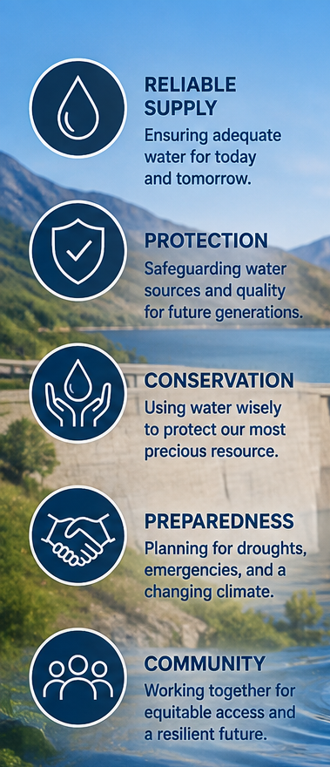
Recommendations
Continue recharge at a rate practical to JBWD
Continue monitoring water levels and Nitrates in all wells.
Shift production away from Well 10 if the district has sufficient operational flexibility.
With recharge continuing, in the future possibly use Well 10 as a standby well
Monitor water levels near Recharge to prevent future septic intercept
Consult with Colorado RWQCB and the USGS to establish a do-not-exceed groundwater level to prevent septic intercept

Slide 27


